Slide 1

Notes:
Add Ms. Wesson Bitmoji Picture☺

Slide 2

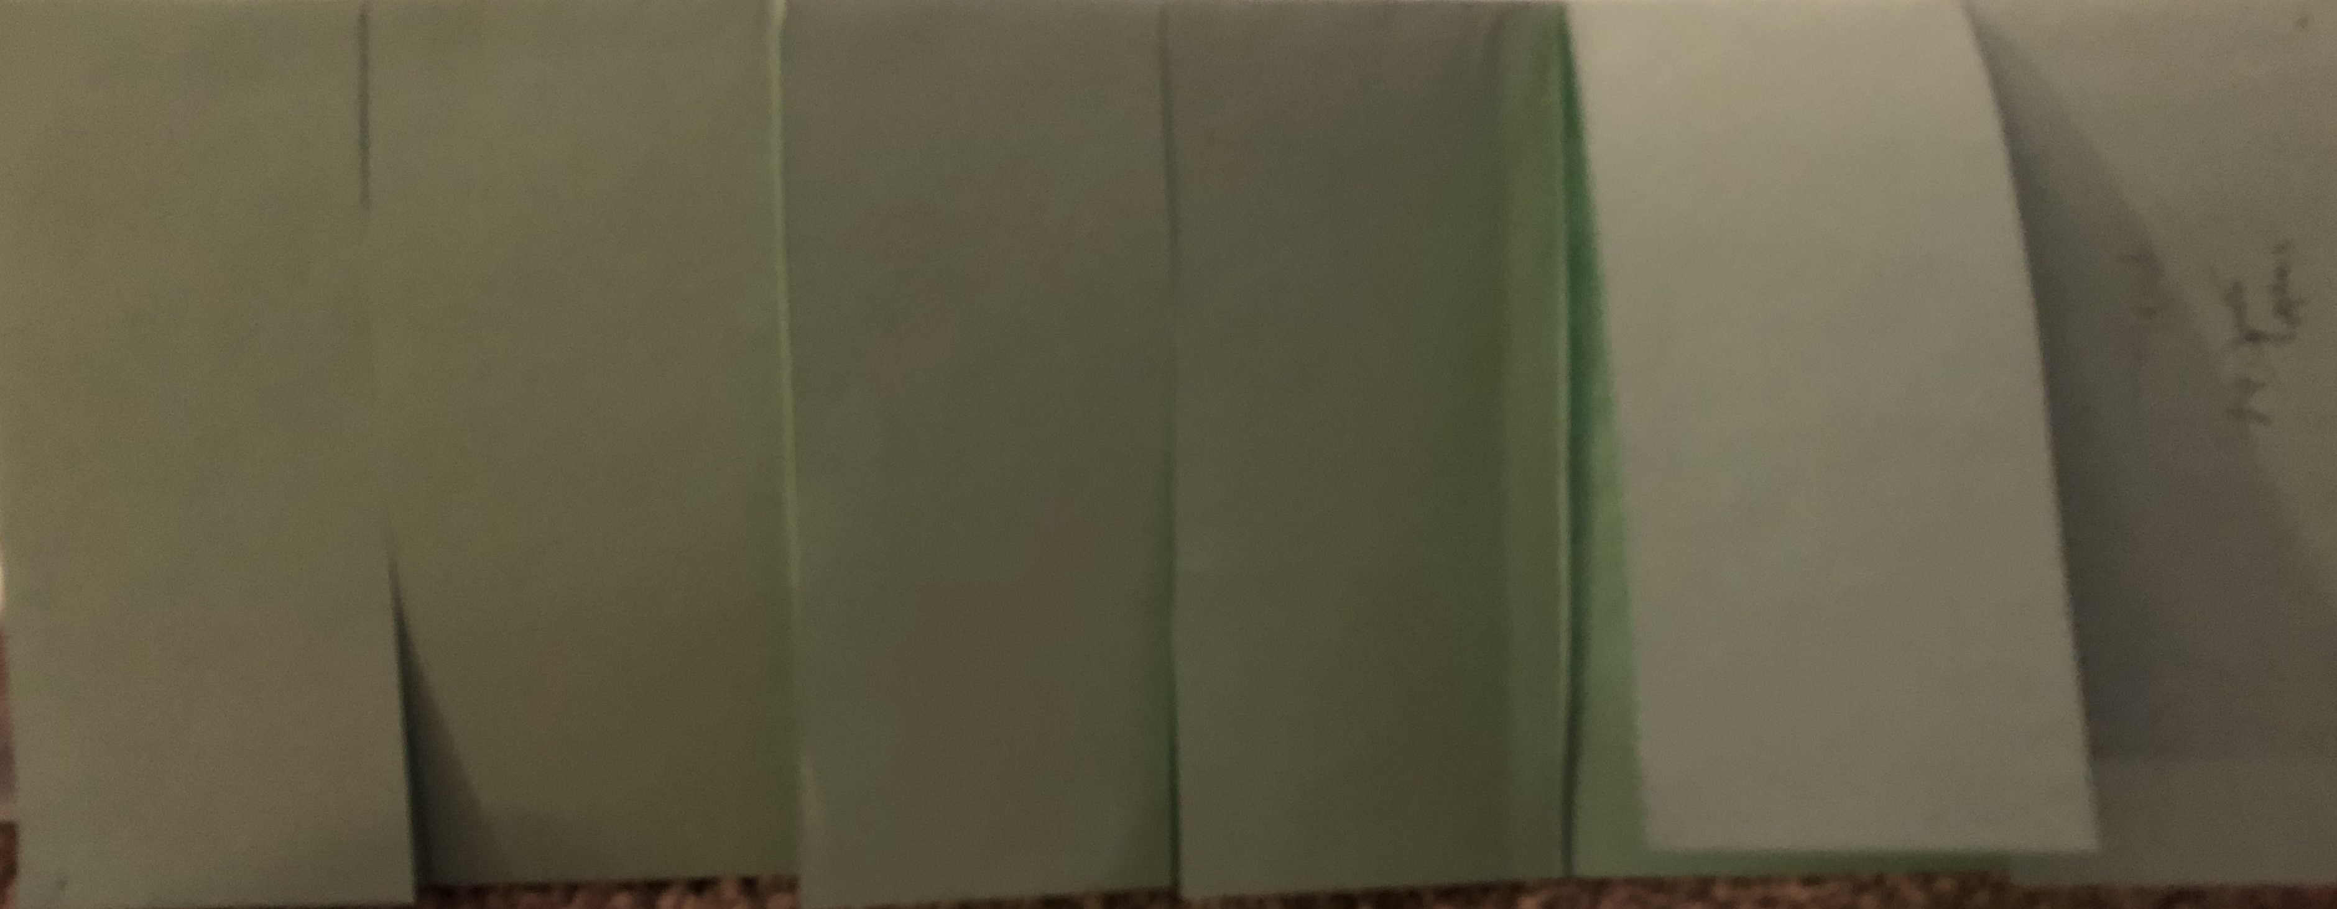
Square Roots- Simplifying Radicals Agenda (2): 8/28/2020
Part I (14):
  Finalize SKI Test
  Create flap 1 foldable
  Part I
  Perfect Square Roots
  Non-Perfect Square Roots
  Perfect/Non-Perfect Method
  Ladder Method
  Tree Method
Part II (14):
Create flap 2 foldables
  Part II
  Adding Radicals/Simplify
  Subtracting Radicals/Simplify
Part III (14):
Create flap 3 foldables
Part III
Multiplying Radicals/Simplify
Part IV (14):
Create flap 4 foldable
Part IV
Radicals Simplify with Constants/Variables
Part V (14):
Delta Math HW
Part V
Square Roots
Simplify Radicals
+, -, x Radicals

Slide 3
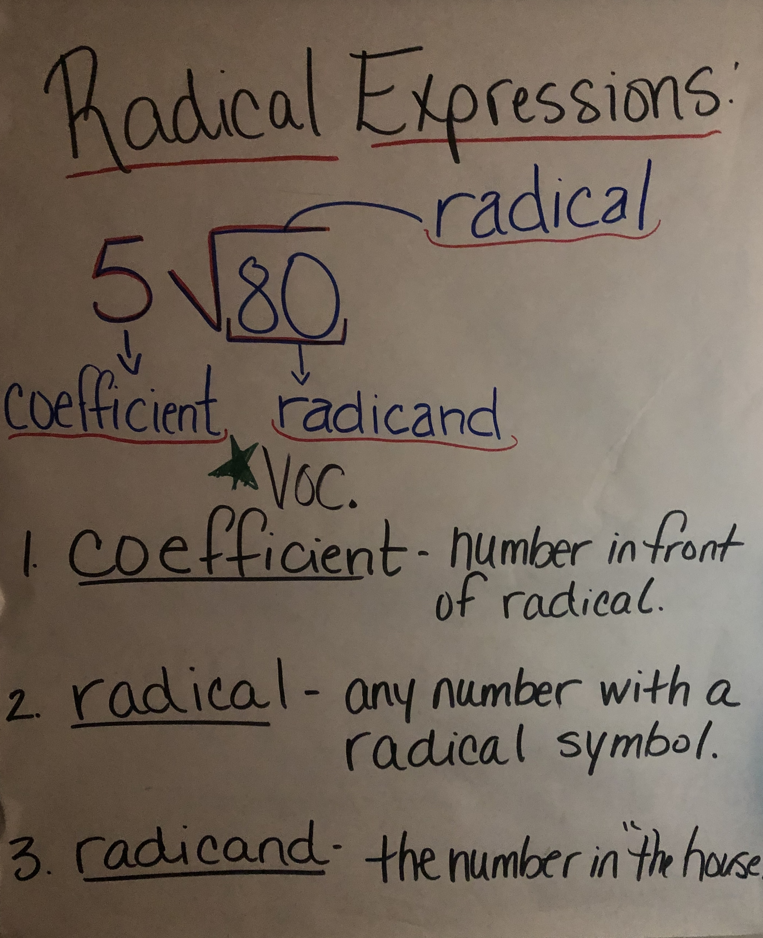
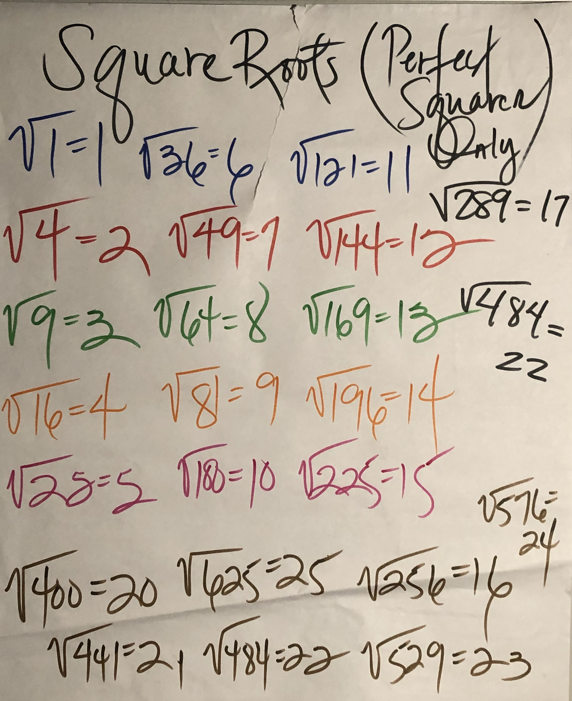

Part I GP/CFU (10)

Slide 4
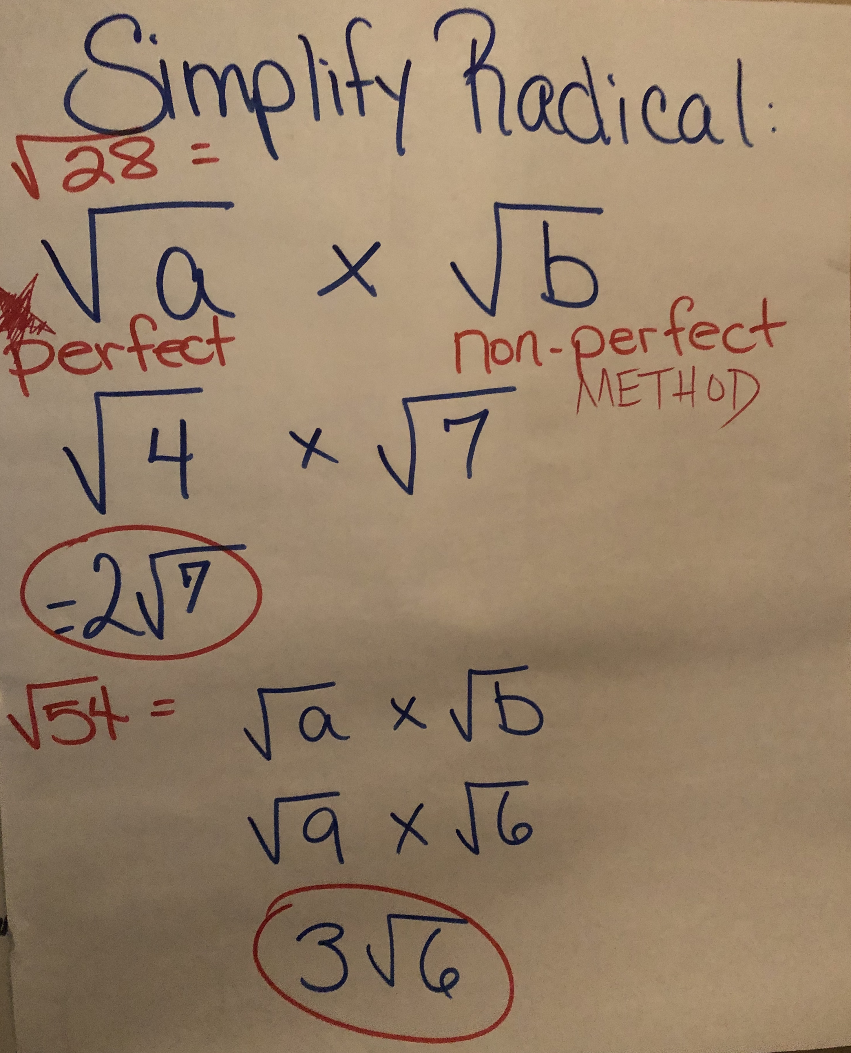
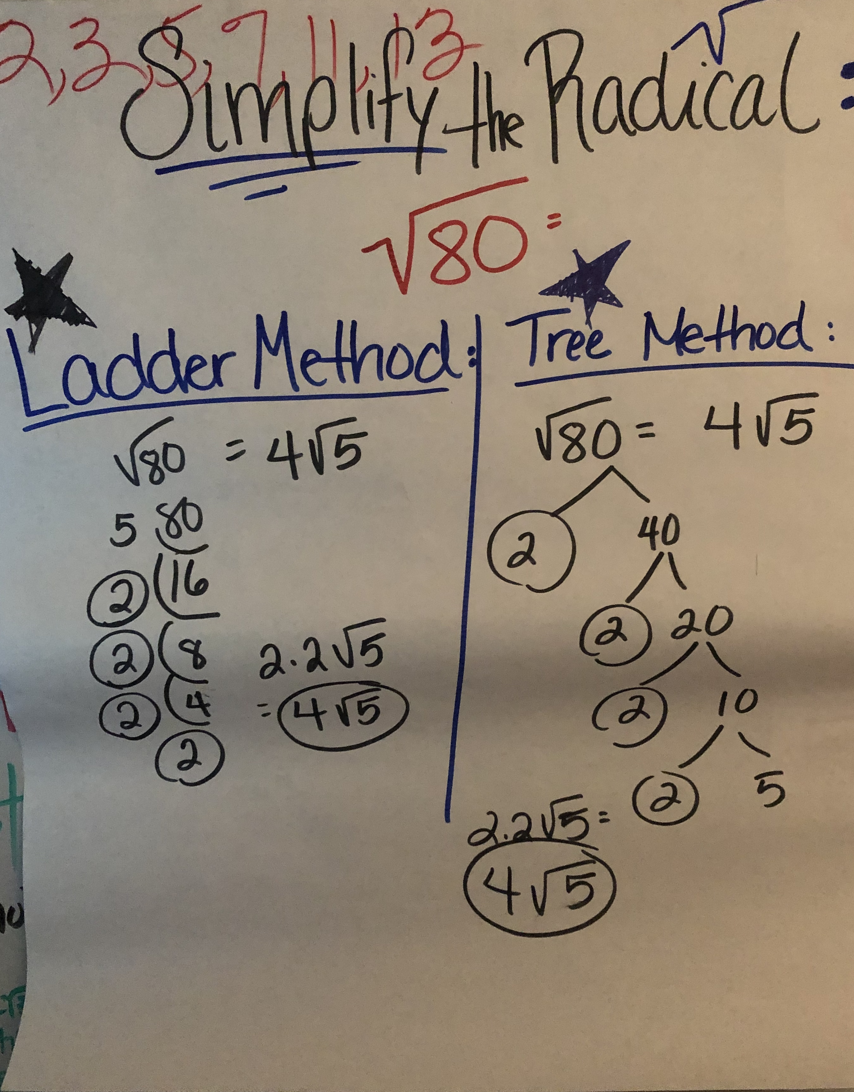

Part II GP/CFU (10)

Slide 5

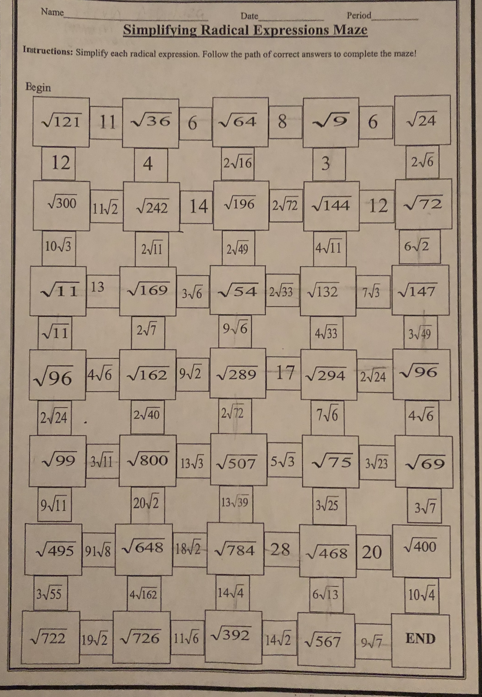
Part III GP/CFU (10)

Slide 6
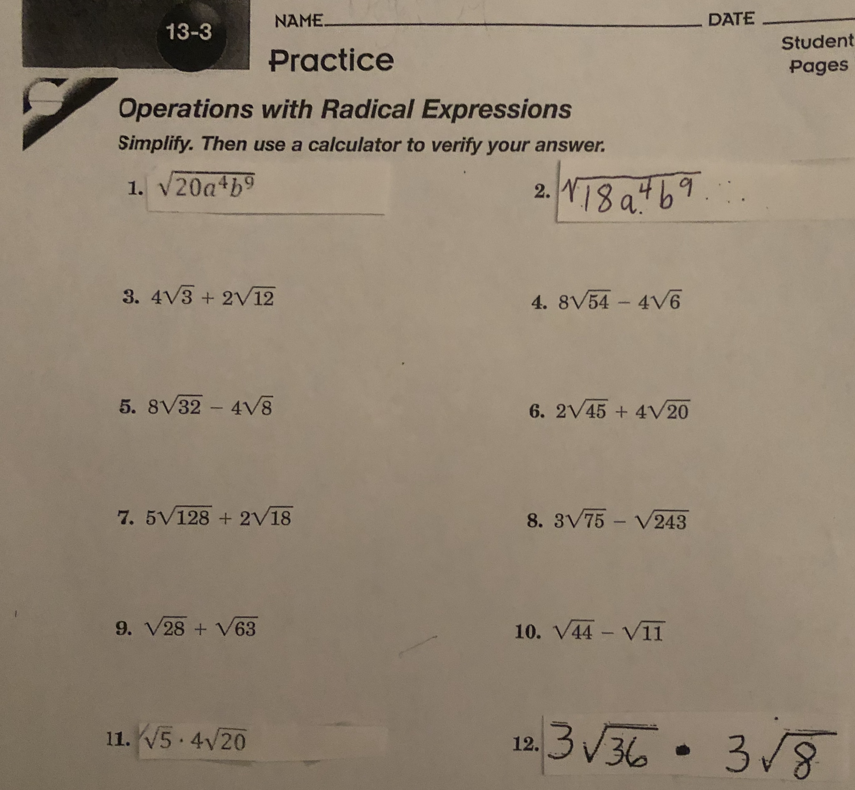

Part IV GP/CFU (10)
I/We Do: 1,3,4,11
You Do: 2,6,5,12

Slide 7
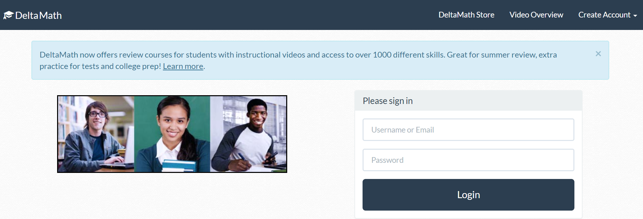

Part V (30) Assessment

Slide 8

Tasks Completed!
Congratulations! You have completed all of the tasks for today!

