Slide 1

Warm-Up Part 1 9/22/2020
Pledge/Announcements/What is your average in FOA?
Jason takes 40 minutes to walk 5 miles.
Jenny takes 27 minutes to walk every 3 miles. What would be the slope of the line?
Who is walking faster? How do you know?
***Take 5 minutes to think it through!***

Slide 2
Finding Rate
Jason takes 40 minutes to walk 5 miles. What is Jason’s constant of proportionality for minutes per mile?
Rate: 40 minutes ÷ 5 ＝
5 miles ÷ 5 ＝
Jenny takes 27 minutes to walk 3 miles. How would you write the rate?

Slide 3
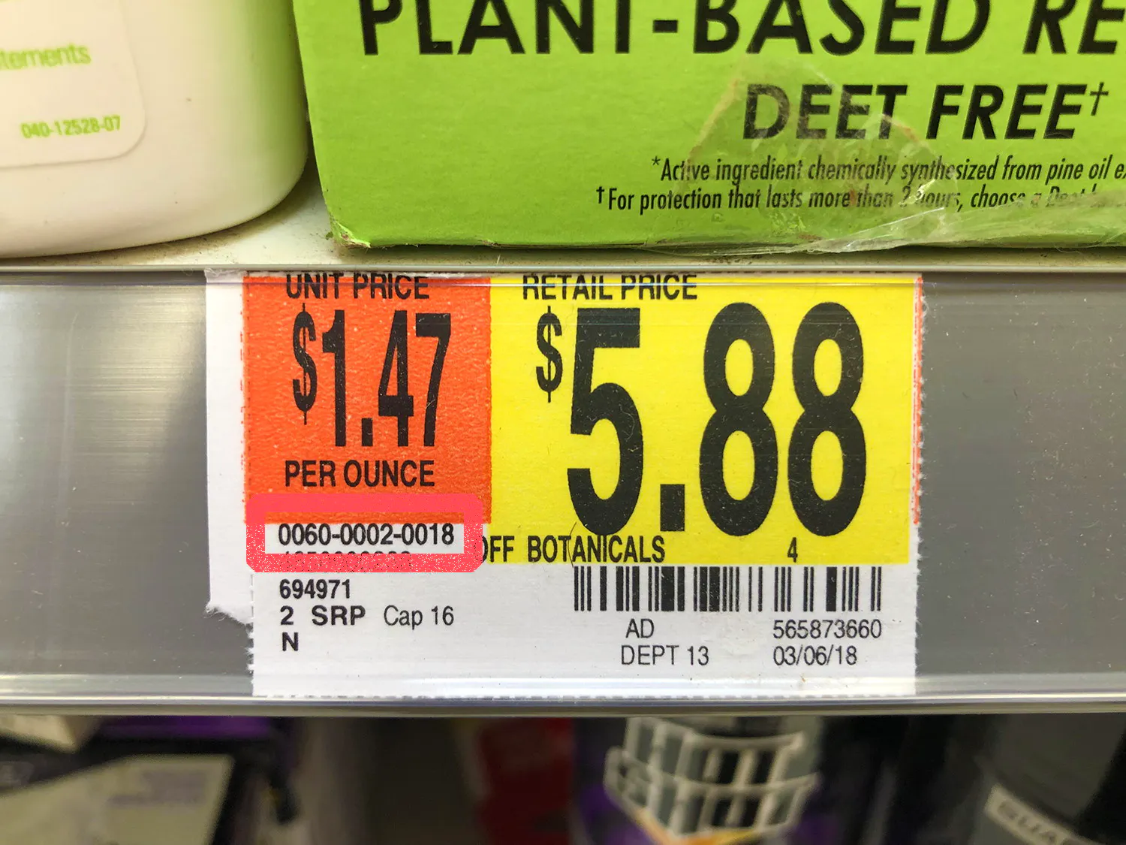
Vocabulary
A rate is a ratio that compares two quantities measured in different units.
The unit rate is the rate for one unit of a given quantity. The “price per”.

Slide 4
Find the Rate
Example 1:
A dog walks 696 steps in 12 minutes. At this rate, how many steps does the dog take in 22 minutes?
The dog takes _______ steps in 22 minutes.
1. Write a rate that compares steps and minutes.
2. Divide the numerator and denominator by 12:
3. Simplify:

Slide 5
Find the Rate
Example 2:
To make 18 smoothies, Henry needs 45 cups of ice. How many cups of ice does he need for one smoothie?
Henry needs ________ cups of ice per smoothie.
1. Write a rate that compares cups of ice and smoothies:
2. Divide the numerator and denominator by 18:
3. Simplify:

Slide 6
Unit Rate Hints!
Things to watch out for:
Each = 1
Per = 1
The unit you want to make 1 is the denominator.
Example: 12 gallons of gas cost $30. What is the price per (for one) gallon?
Rate $30/(12 gallons) In the calculator, enter 30/12.

Slide 7

Go Formative Part I MWLA6D
Asia bought 12 pounds of oranges for $14.70. Doreen bought 7 pounds of oranges for $8.95.
Who got the better deal? Asia or Doreen?
**Hint: Find the unit rate for price per 1lb of apples**

Slide 8
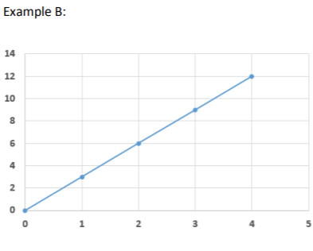
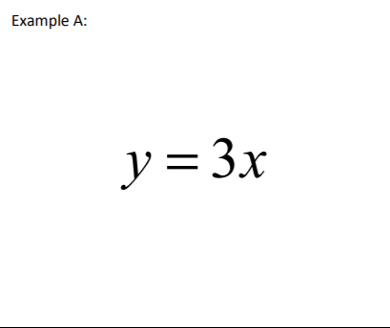
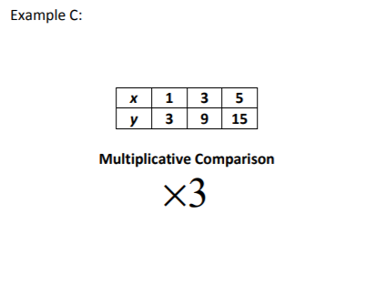
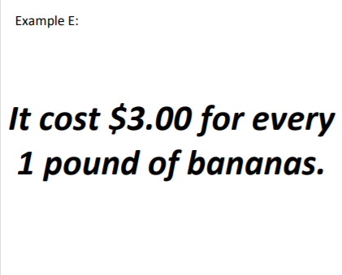
Let’s Observe!
Warm-up Part II 9/22/2020
Take a few minutes to observe the following 2 data items.
What do you notice about “K”
between the 2 data items?
y = 8x

Slide 9
Unit Rate Ways
1. Word Problem: Every glass of lemonade requires 4 lemons.
X (Glass) | 1 | 2 | 3 | 4
Y (lemons) | 4 |  |  | 16
Table:
2.Equation:
Y = _____ X
-What was the constant rate of change in the lemons per glass? ________ lemons
-

Slide 10
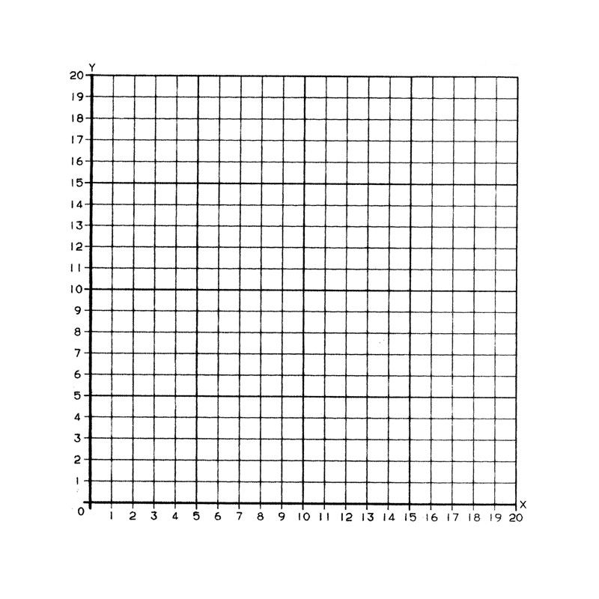
The table below shows the number of lemons for each glass. If the pattern continues, how many lemons will be needed with 15 glasses?
X (glass) | Y (lemons)
1 | 75
2 | 150
3 | 225
4 | 300

Slide 11
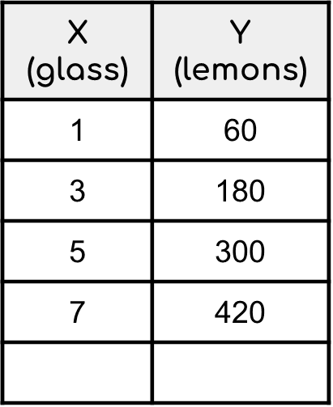
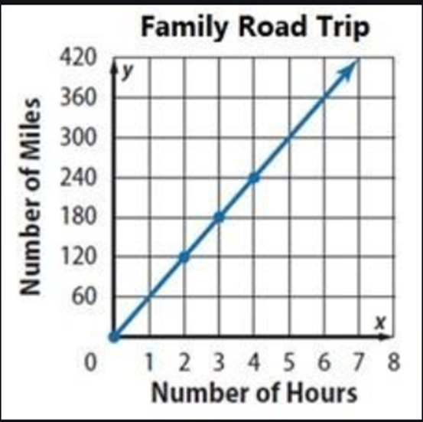
Unit Rate
The table shows the number of miles y, of x number of hours
Explain why the graph shows the correct proportional relationship between the number of hours and the number of miles?

Slide 12
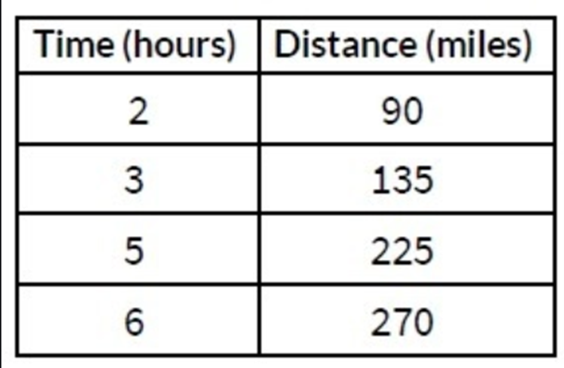
Unit Rate
Find the rate of miles per hour.
How many miles will be driven in 10 hours?

Slide 13
Back to the Warm-Up...
Now that you have context, take a few minutes to look back at the warm up.
What do you notice about the relationship between the two items?
y = x

Slide 14

Go Formative 2
Go to go formative using the link provided in the chat!
1st Block: Q36TBL 2nd Block: BZXHW6 4th Block: TCBFHG
Things to watch out for:
Each = 1
Per = 1
The unit you want to make 1 is the denominator.
Example: 12 gallons of gas cost $30. What is the price per (for one) gallon?
Rate $30/(12 gallons) In the calculator, enter 30/12.

Slide 15
Closing
Delta Math Assignment - Module 3: Finding Unit Rate
Reminder: Module 3 test make-up will be TBD
**Go to the Tutoring class and join the Test make-up Session**

Slide 16
Proportional Relationships
Warm-up Part III 9/22/2020
How are proportional relationships recognized and represented?
How is a constant of proportionality (unit rate) identified in various representations?

Slide 17
Definition:
Y varies directly as x means that y = kx where k is the constant of proportionality.
Another way of writing this is k =
In other words:
* the constant of proportionality (k) in a proportional relationship is the constant (unchanged) ratio of two variable quantities.

Slide 18
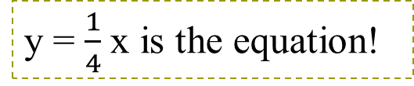
Examples of Proportional Relationship:
Write an algebraic expression that describes the relationship between x and y.
y = 2x is the equation!
y = 3x is the equation!

Slide 19
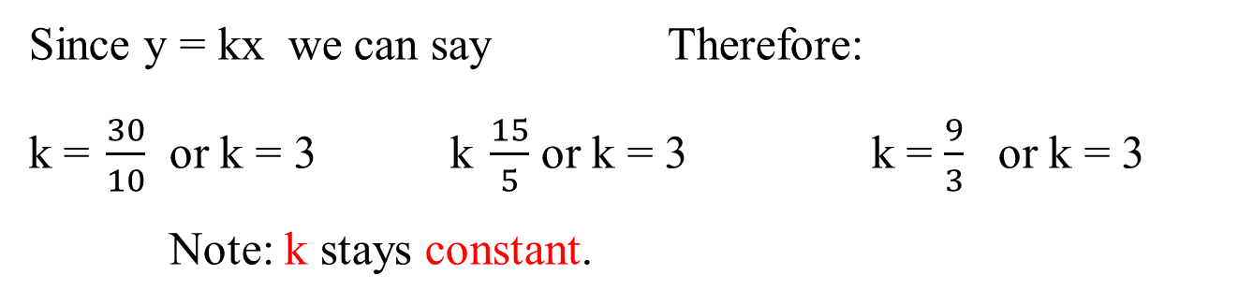
Examples of Proportional Relationship:
y = 3x is the equation!
What is the constant of proportionality of the table above?

Slide 20
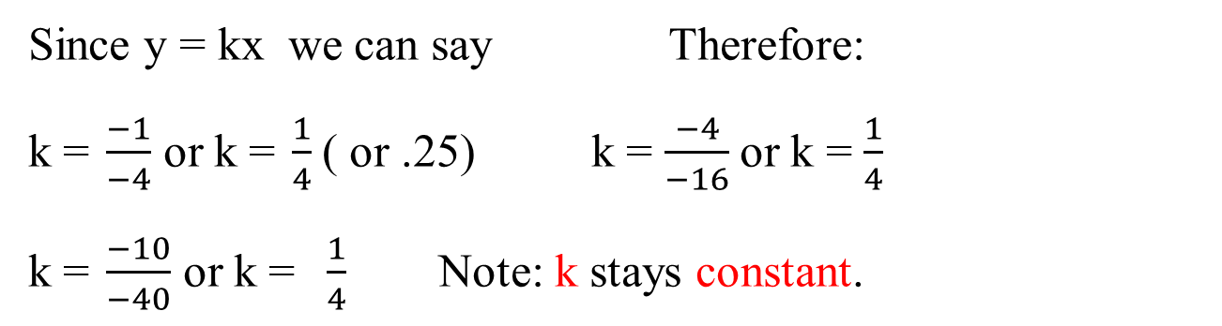
Examples of Proportional Relationship:
OR
y = .25x is the equation!
What is the constant of proportionality of the table above?

Slide 21
What is the constant of proportionality for the following table?
2
-2
-½
½
Answer Now

Slide 22
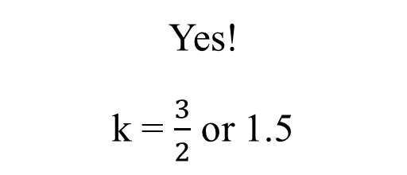
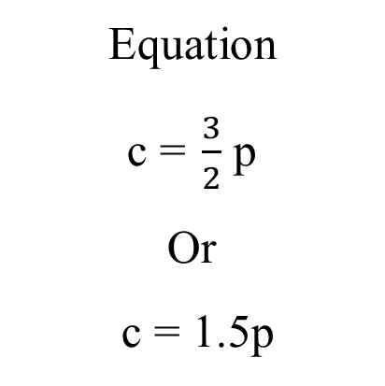
Is this a proportional relationship of y? If yes, give the constant proportionality of (k) and the equation.

Slide 23
Is this a proportional relationship of y? If yes, give the constant proportionality of (k) and the equation.
No!
The k values are different!

Slide 24
What is the difference between the rate of change of these two functions?
y = 6x + 1

Slide 25
Is this a proportional relationship of y? If yes, give the constant proportionality of (k) and the equation.
Cost of Iced-Tea Mix
Yes!
k = 475 cents
Equation
p = 4.75c

Slide 26
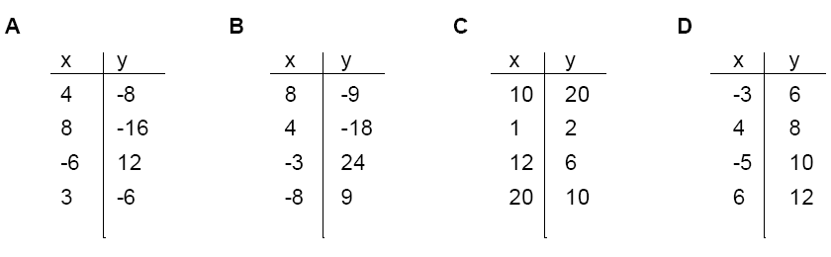
Which of the following represent a proportional relationship?
A
B
C
D
Answer Now

Slide 27
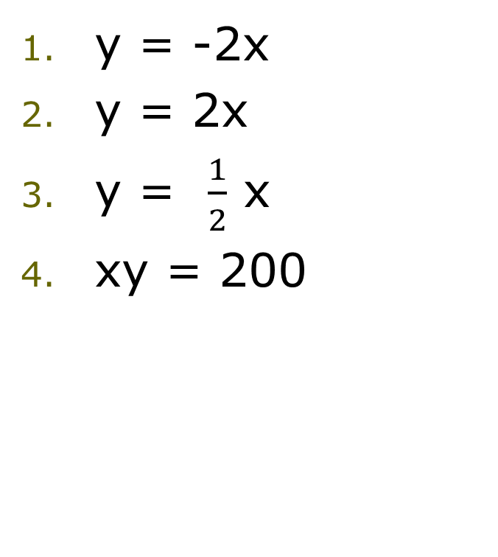
Which is the equation that describes the relationship in following table of values?

Slide 28

Putting it all Together Part IV 9/21/2020
Module 3 Study Guide – Test will be on Thurs 9/24/2020
Calculator Reminder: www.desmos.com/scientific
Goformative Rally Coach Chat: 1st Q36TBL 2nd BZXHW6 4th TCBFHG
1.

Slide 29

Padlet Projected Test % Feedback

Slide 30
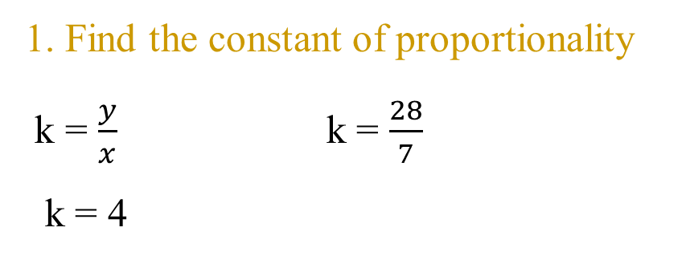
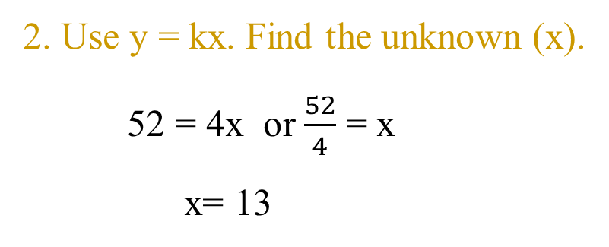
Extended: Using Proportional Relationship to find unknowns (y = kx)
Given that y varies directly with x, and y = 28 when x=7, Find x when y = 52. HOW???
2 step process
Therefore:
X =13 when Y=52

Slide 31
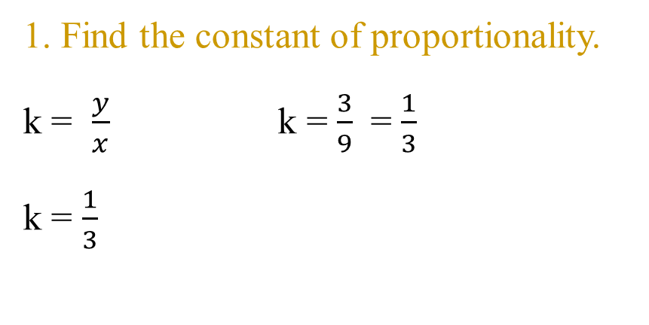
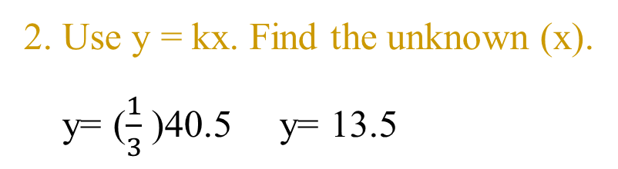
Using Direct Variation to find unknowns (y = kx)
Given that y varies directly with x, and y = 3 when x=9,
Find y when x = 40.5. HOW???
2 step process
Therefore:
X =40.5 when Y=13.5

Slide 32
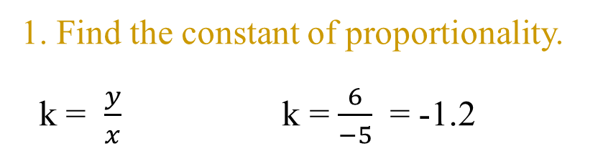
Using Direct Variation to find unknowns (y = kx)
Given that y varies directly with x, and y = 6 when x=-5,
Find y when x = -8. HOW???
2 step process
2. Use y = kx. Find the unknown (x).
y= -1.2(-8)
x= 9.6
Therefore:
X =-8 when Y=9.6

Slide 33
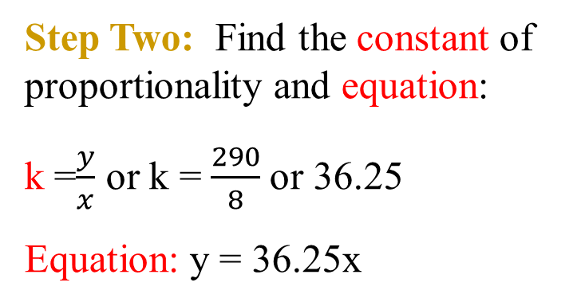
Using Direct Variation to solve word problems
Problem:
A car uses 8 gallons of gasoline to travel 290 miles. How much gasoline will the car use to travel 400 miles?
Step One: Find points in table
Step Three: Use the equation
to find the unknown.
400 =36.25x
400 =36.25x
36.25 36.25
x = 11.03
Notes:
Step 3: 60 seconds to solve

Slide 34
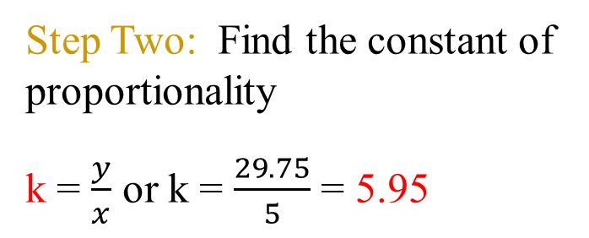
Using Direct Variation to solve word problems
Problem:
Julio wages vary directly as the number of hours that he works. If his wages for 5 hours are $29.75, how much will they be for 30 hours
Step One: Find points in table.
Step Three: Use the equation
to find the unknown.
y=kx
y=5.95(30)
y=178.50

Slide 35
Part IV 9/22/2020
Proportional Relationships and its graph
The equation that represents the constant of proportionality
is y = kx
The graph will always go through…

Slide 36
Write the equation that represents the slope-intercept form of the line on the graph?

Slide 37
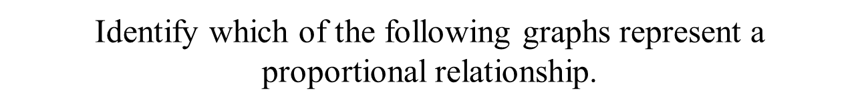

Yes
No
No
No

Slide 38

Identify which of the following graphs represent a proportional relationship.
No
Yes
Yes
No

Slide 39
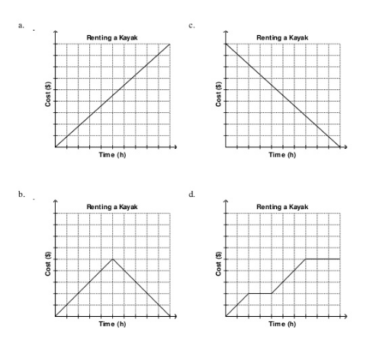
Which graph represent the slope of cost decreasing per time?

Slide 40
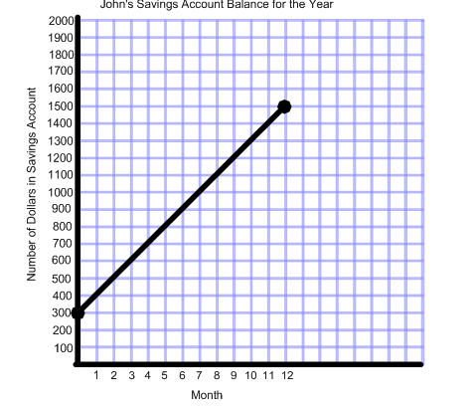
Does the following graph represent a proportional relationship?
Explain your reasoning

Slide 41
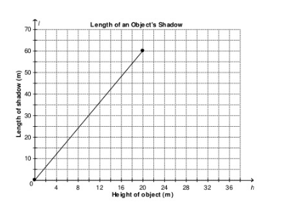


Explain the relationship between the height of object and the length of shadow?
(20, 60)
Find the constant of variation and equation
(10, 30)

Slide 42
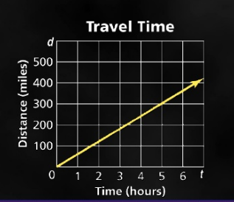
Tommy traveled 300 miles in 5 hours. Explain the distance traveled in time.

Slide 43
Write an equations that represents the proportional relationship between the time in class x and the number of pages y.
Liana takes 2 pages of notes during each hour of class.
Create a table & graph to represent the proportional relationship
http://www.ixl.com/math/grade-8/proportional-relationships-word-problems

Slide 44
Peter earns $1.50 for every cup of lemonade he sells. Write an equation that shows the relationship between the number of cups sold x and the earnings y.
Delfina's graduation picnic costs $35 for every attendee. Write an equation that shows the relationship between the attendees (a) and the cost (c).
Sajan can bake 6 cookies with each scoop of flour. Write an equation that shows the relationship between the scoops of flour x and the cookies y.
DJ's earns a flat rate of $45 for clocking in, while earning $30 per hour in sales. Write an equation that represents the amount of money (y) DJ makes for working x hours?
Mitch can grow 150 wild flowers with every seed packet. Write an equation that shows the relationship between the number of seed packets (p) and the total number of wild flowers (w).

