Slide 2
Square Roots, Simplifying Radicals + Expressions Agenda: 8/31/2020
Part I (14):
Pledge of Allegiance
SKI Test During Tutoring Hours at 1:30PM use zoom code from Remind
Create flap 1 foldable
Part I
Perfect Square Roots
Non-Perfect Square Roots
Perfect/Non-Perfect Method
Ladder Method
Tree Method
Part II (14):
Create flap 2 foldables
Part II
Adding Radicals/Simplify
Subtracting Radicals/Simplify
Part III (14):
Create flap 3 foldables
Part III
Multiplying Radicals/Simplify
Part IV (14):
Create flap 4 foldable
Part IV
Radicals Simplify with Constants/Variables
Square Roots
Simplify Radicals
+, -, x Radicals
Part V (14):
Back of Foldable
Expressions
Delta Math Assessment

Slide 3
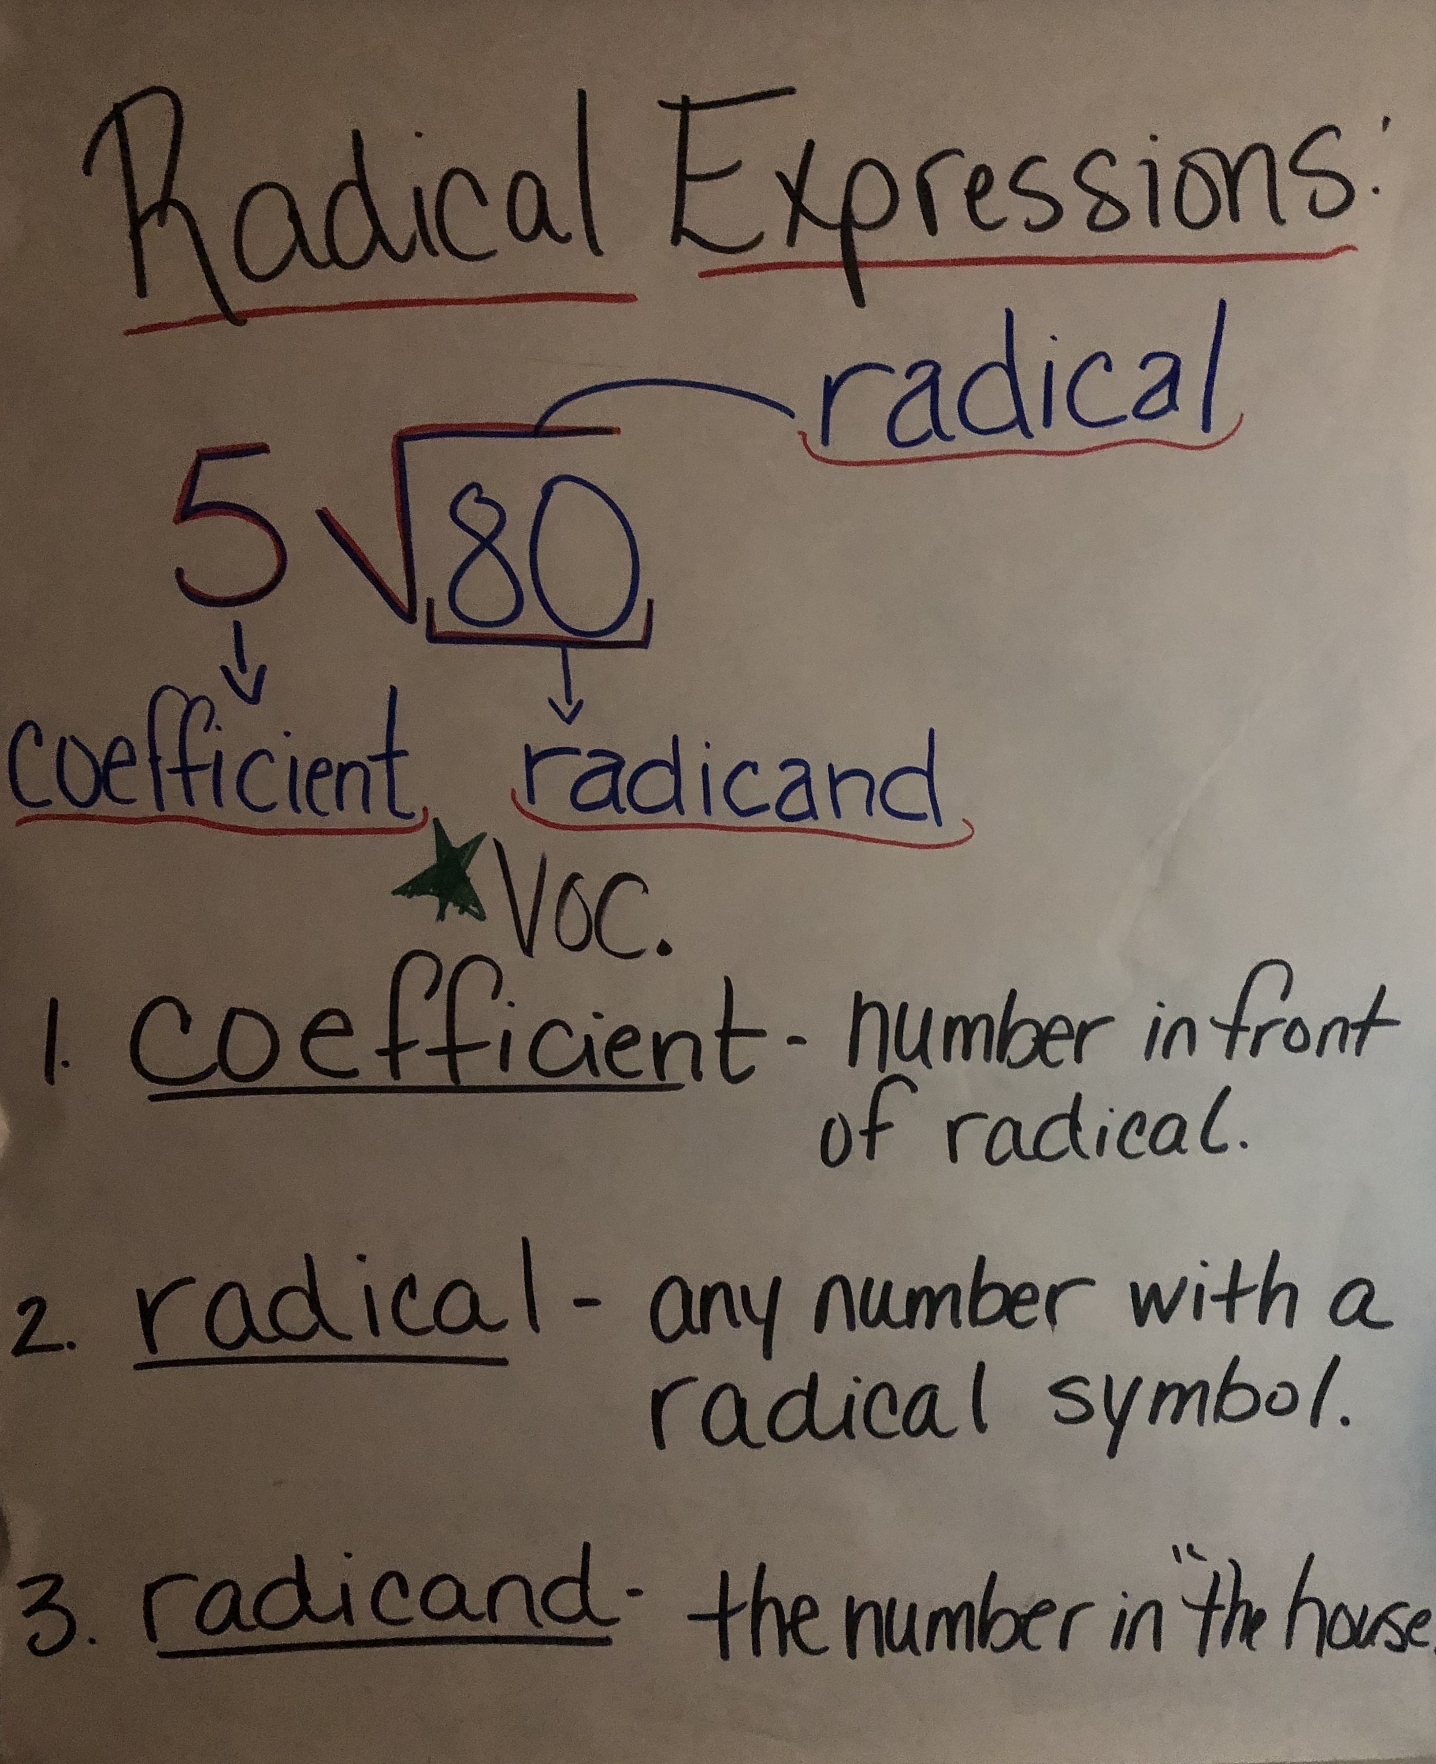
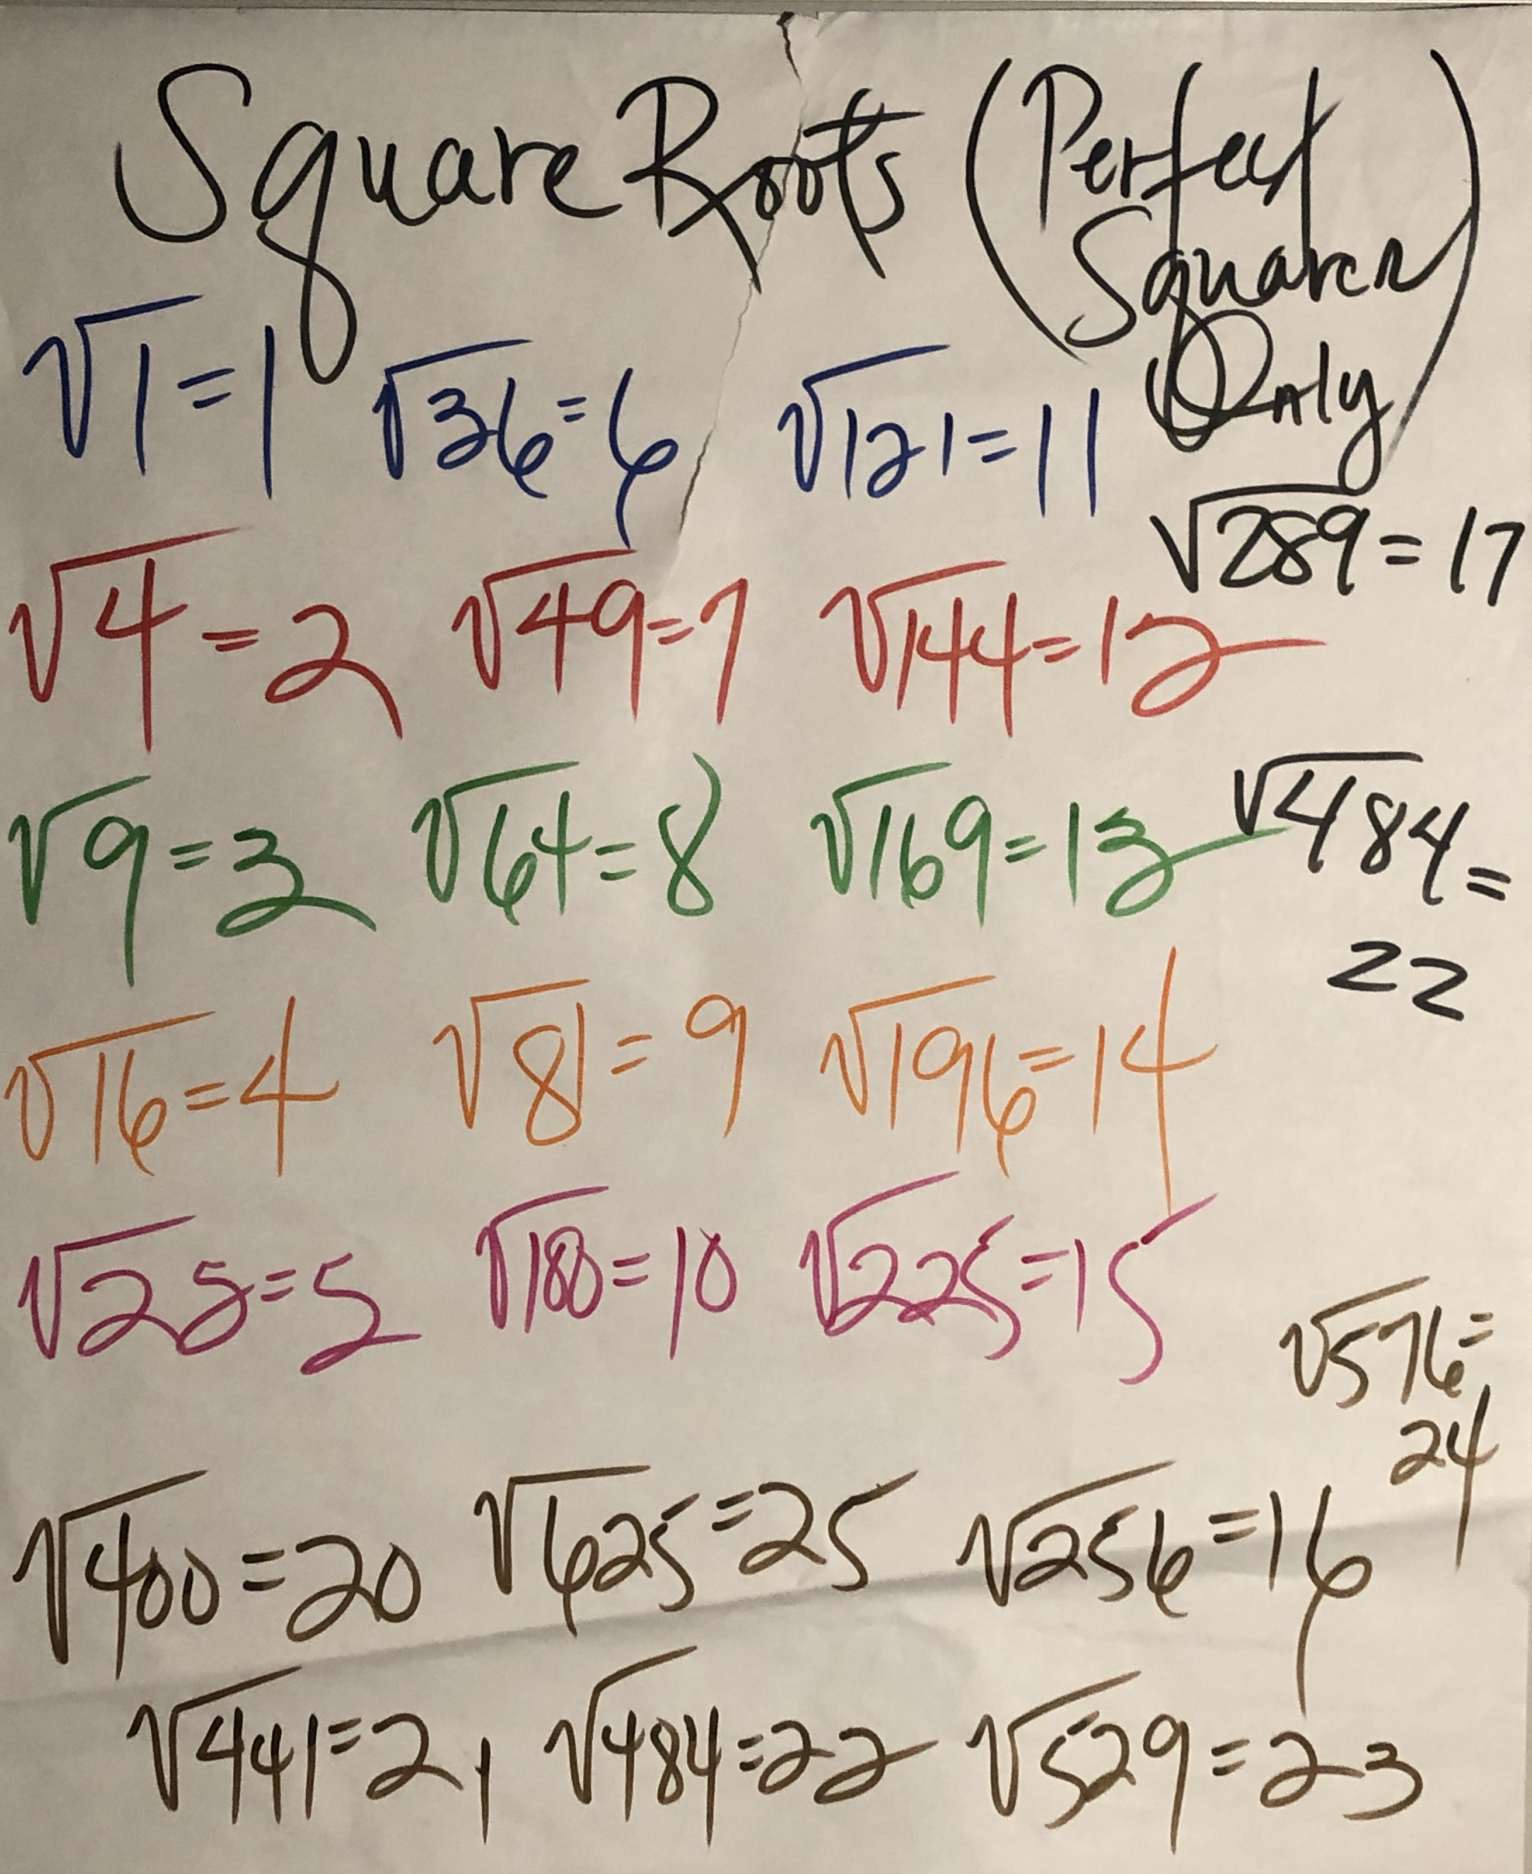
Part I GP/CFU (10)

Slide 4
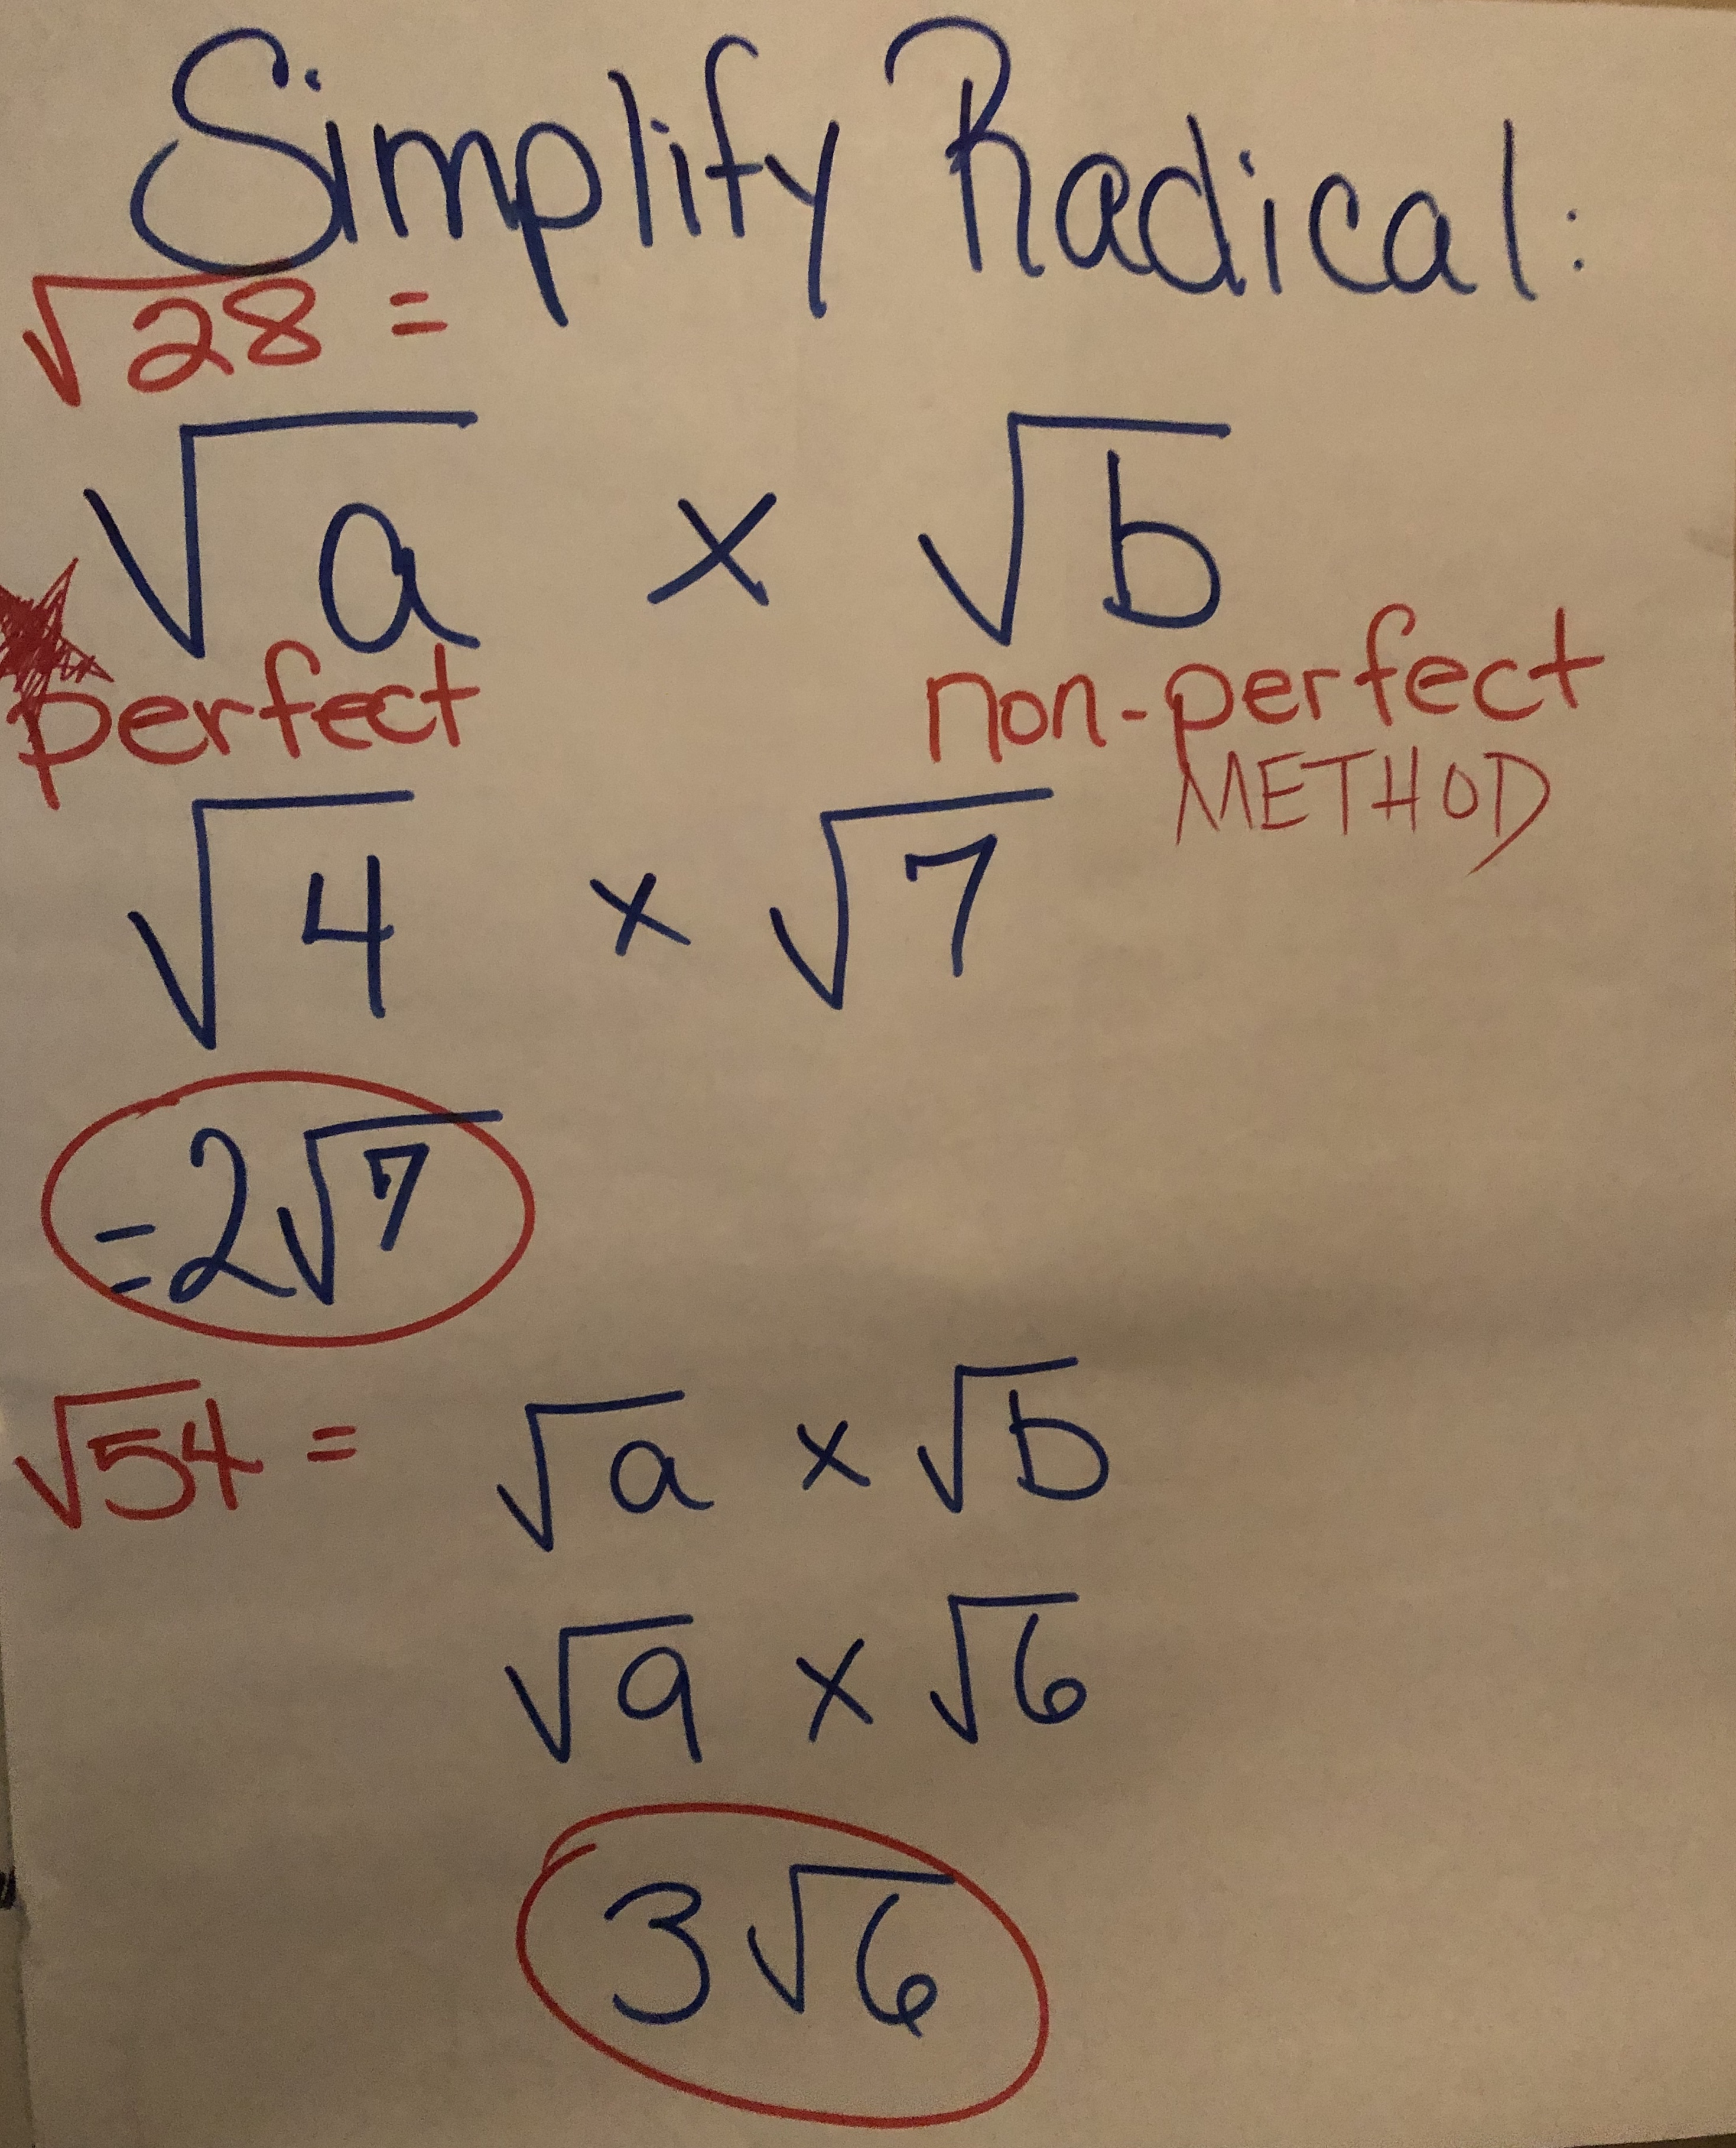
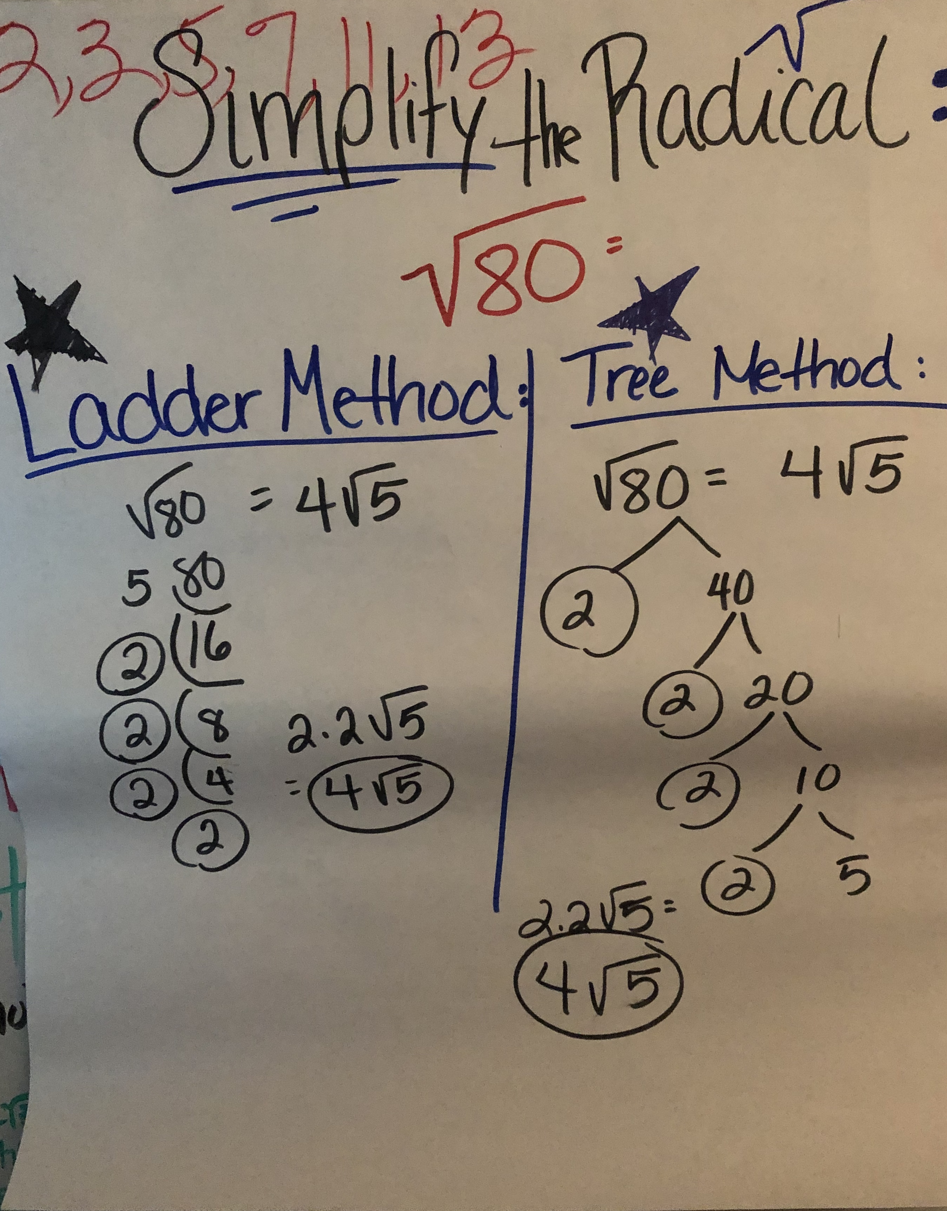
Part II GP/CFU (10)

Slide 5
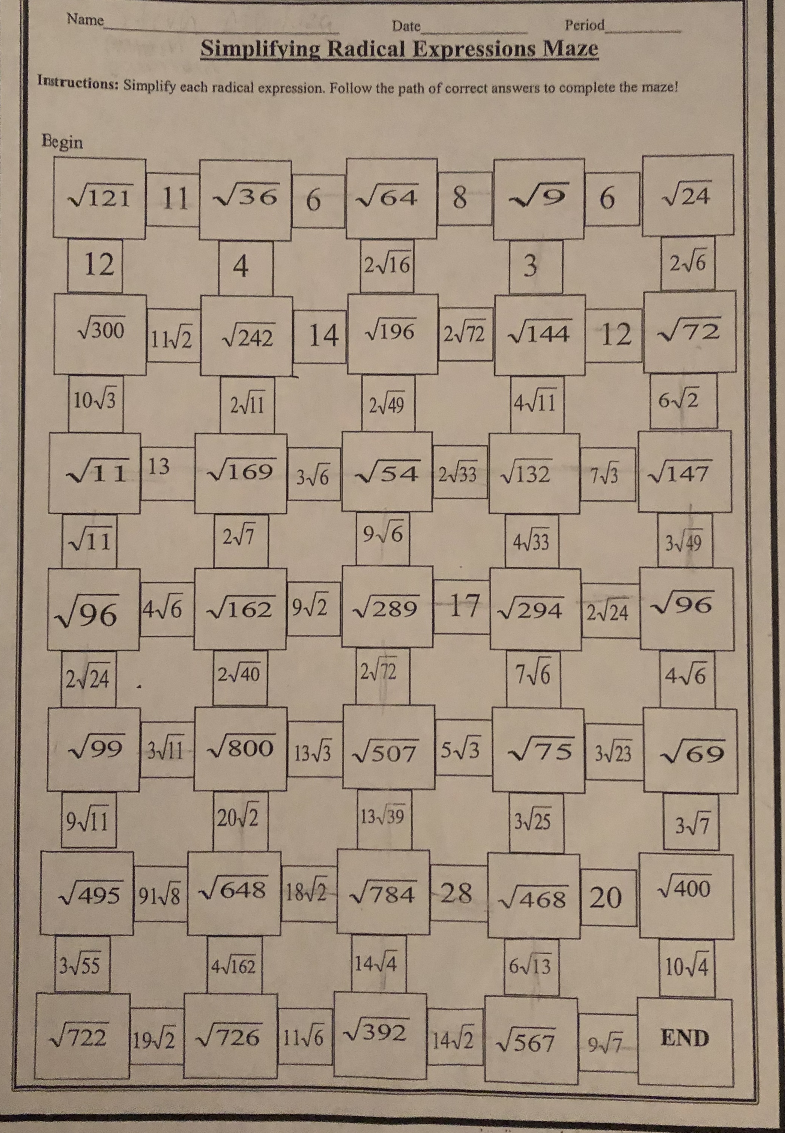
Part III GP/CFU (5)

Slide 6
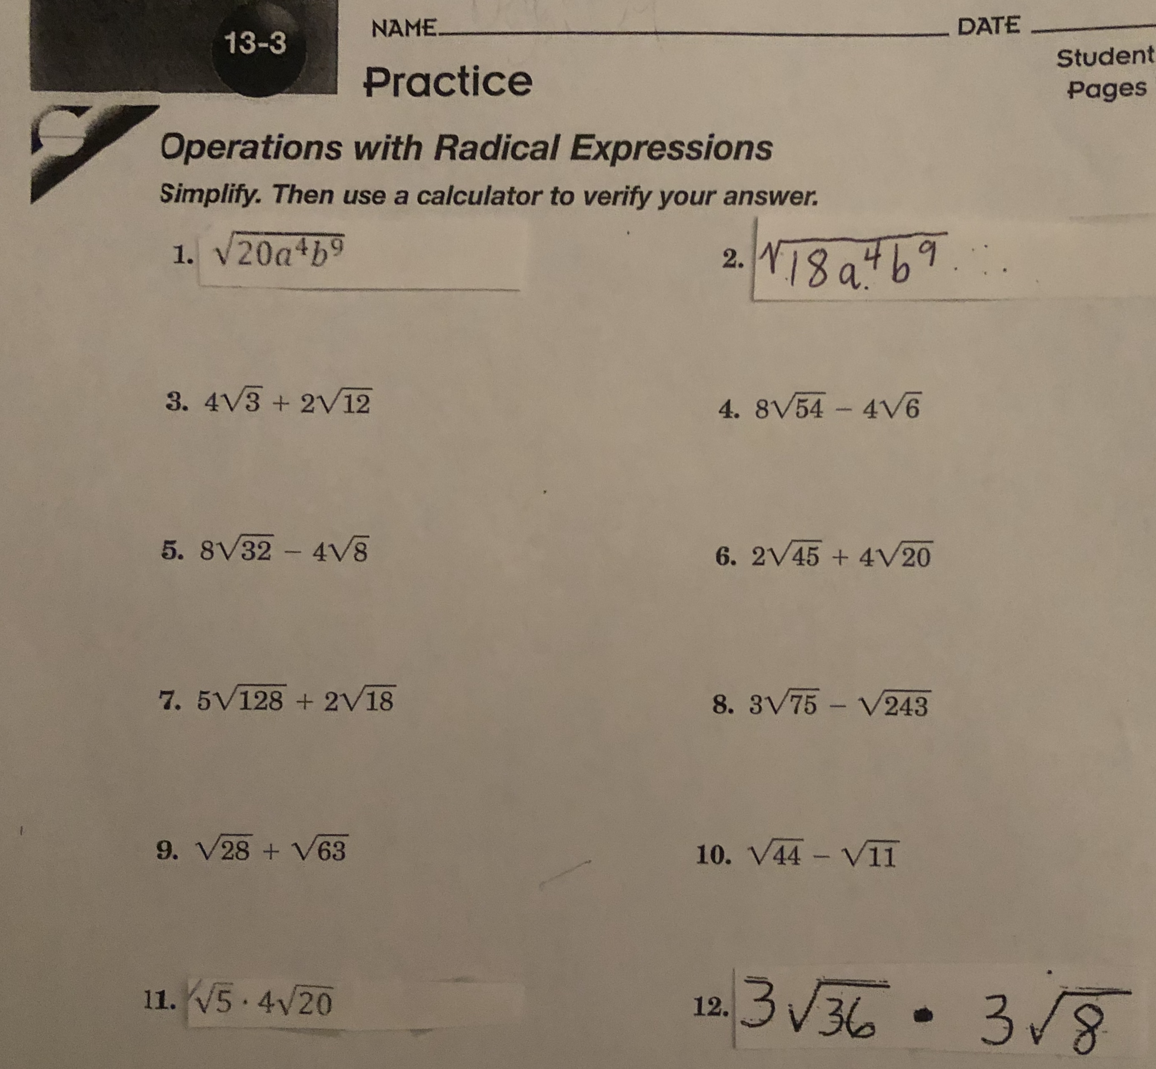
Part IV GP/CFU (10) I/We Do: 1,3,4,11 You Do: 2,6,5,12

Slide 7
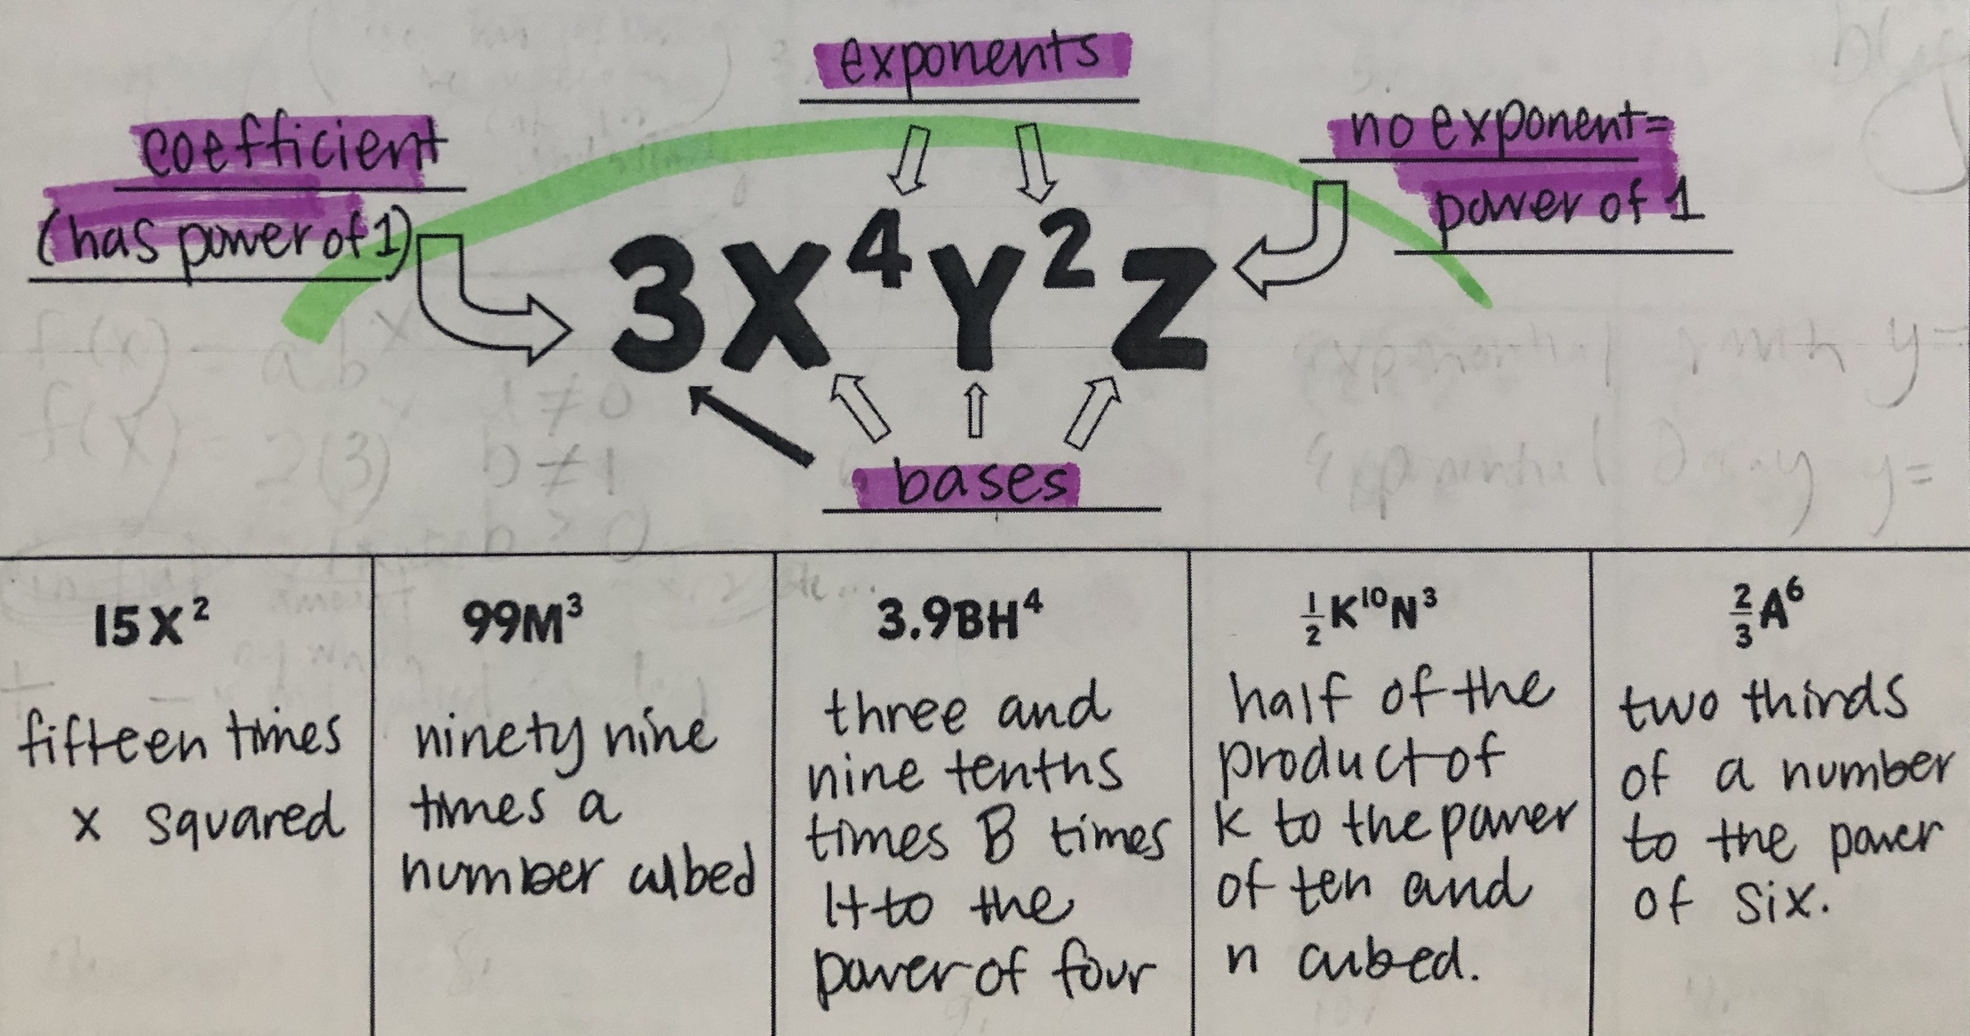
Parts of an Expression (5)

Slide 8
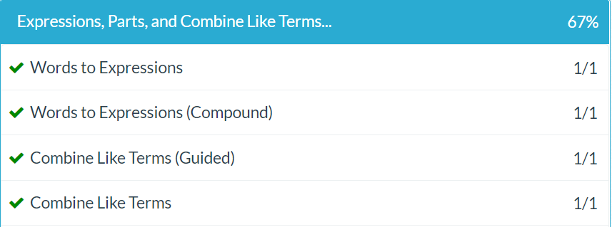
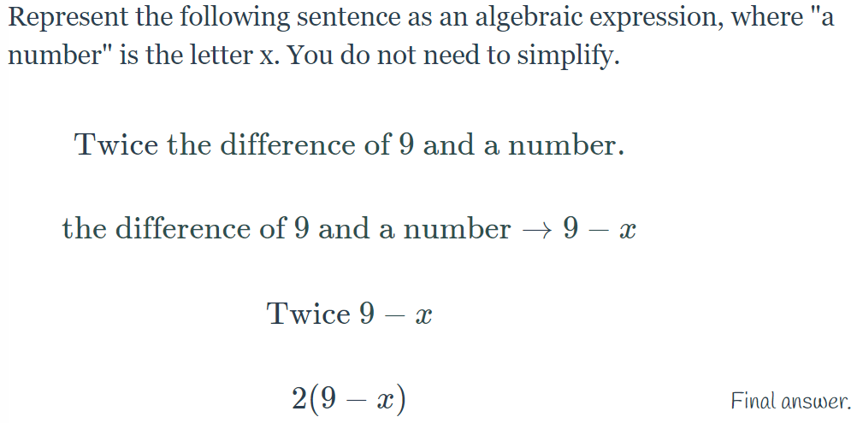
Delta Math Review (5)

Slide 9
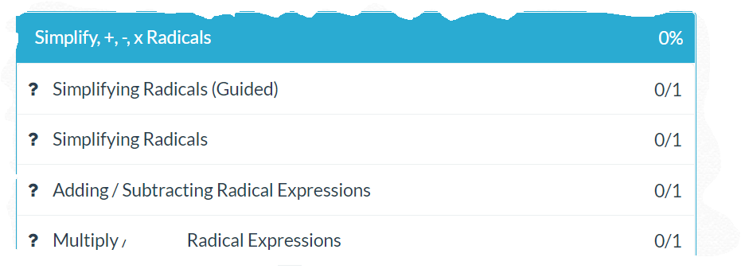
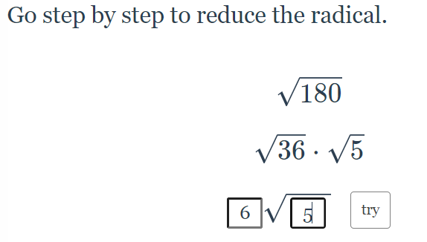
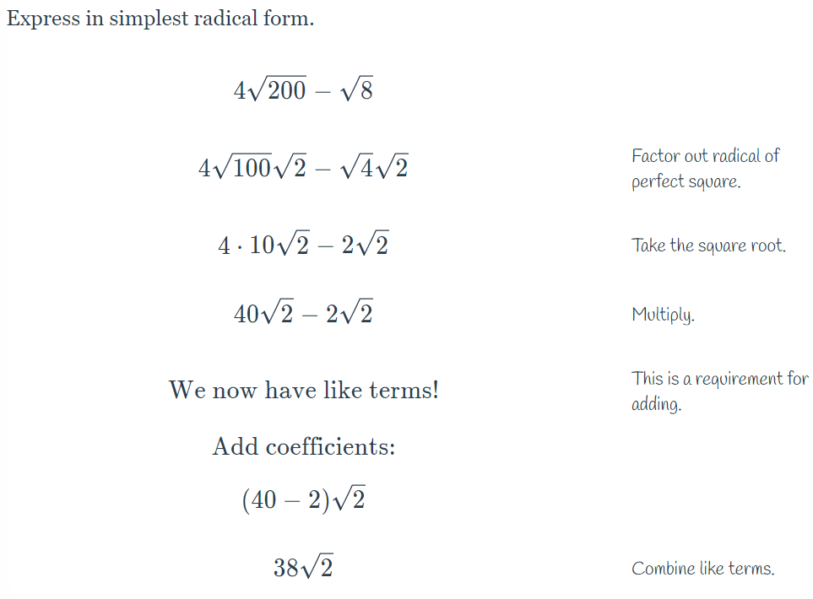
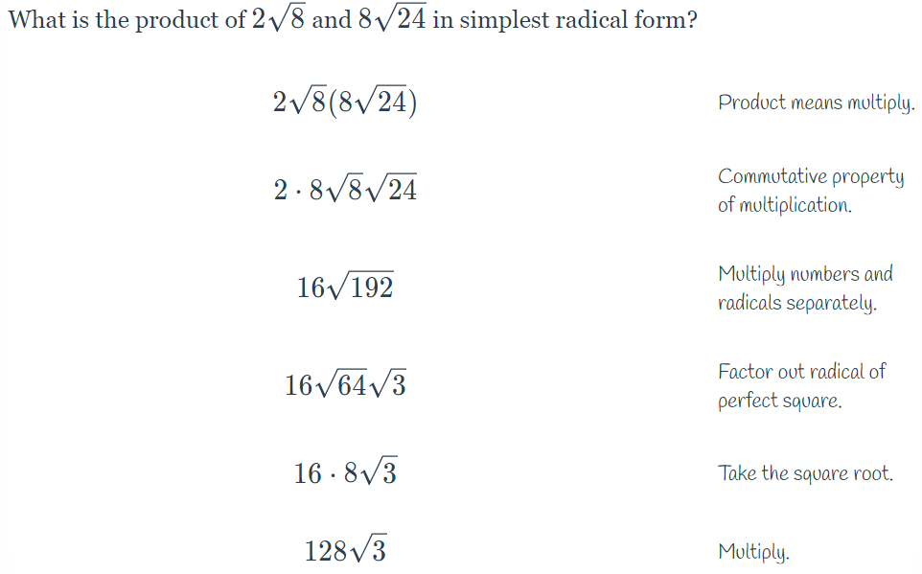
Delta Math Review (5)

Slide 10
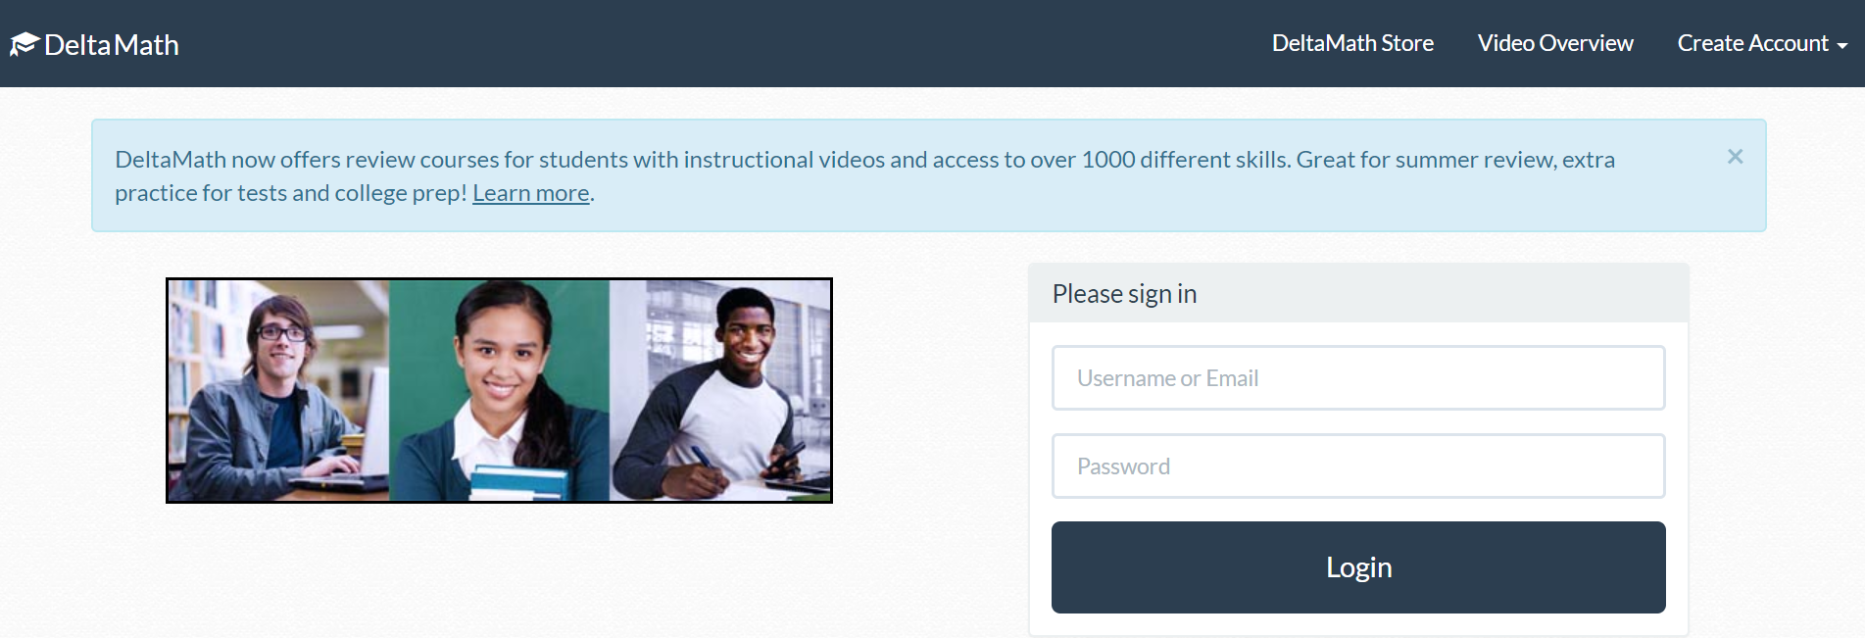
Delta Math/ CTLS Folder(20)

Slide 11
Tasks Completed!!!
Congratulations! You have completed all of the tasks for today!

