Slide 1

Module 4:
Metric System
Welcome to the second 6 wks
Passing % Rate: 100%
45%
79%

Slide 2
October 5 Warm Up
What was the best thing about your fall break? Type it in the chat.
Go to Padlet and Type under your period, your goal average for the Second Six Weeks and reply to one peer to receive credit.

Slide 3
Announcements
Don’t forget Tutoring (P.A. students, let me know if there’s a conflict...)
Next Tuesday, October 13, 2 PM: Retake Module 3 Test
Beginning Monday, October 5, if a student does not have their camera activated and his or her person not visible, I will be forced to place him or her in the waiting room. This is also a safety and security issue. If there is a viable reason why your student cannot be visible during class, I will need to hear from you in writing for approval from administration.

Slide 4
How many seconds are in one day?
Make your best guestimate! Type them in the chat.

Slide 5
How many seconds are in one day?
How many seconds are in one day? Try to calculate it!
Here is some information that is useful:
1 day = 24 hours
1 hour = 60 minutes
1 minute = 60 seconds

Slide 6
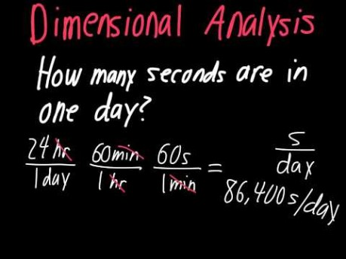
Opening- Dimensional Analysis
Students will use units as a way to understand problems and guide the solutions of multi-step problems.

Slide 7
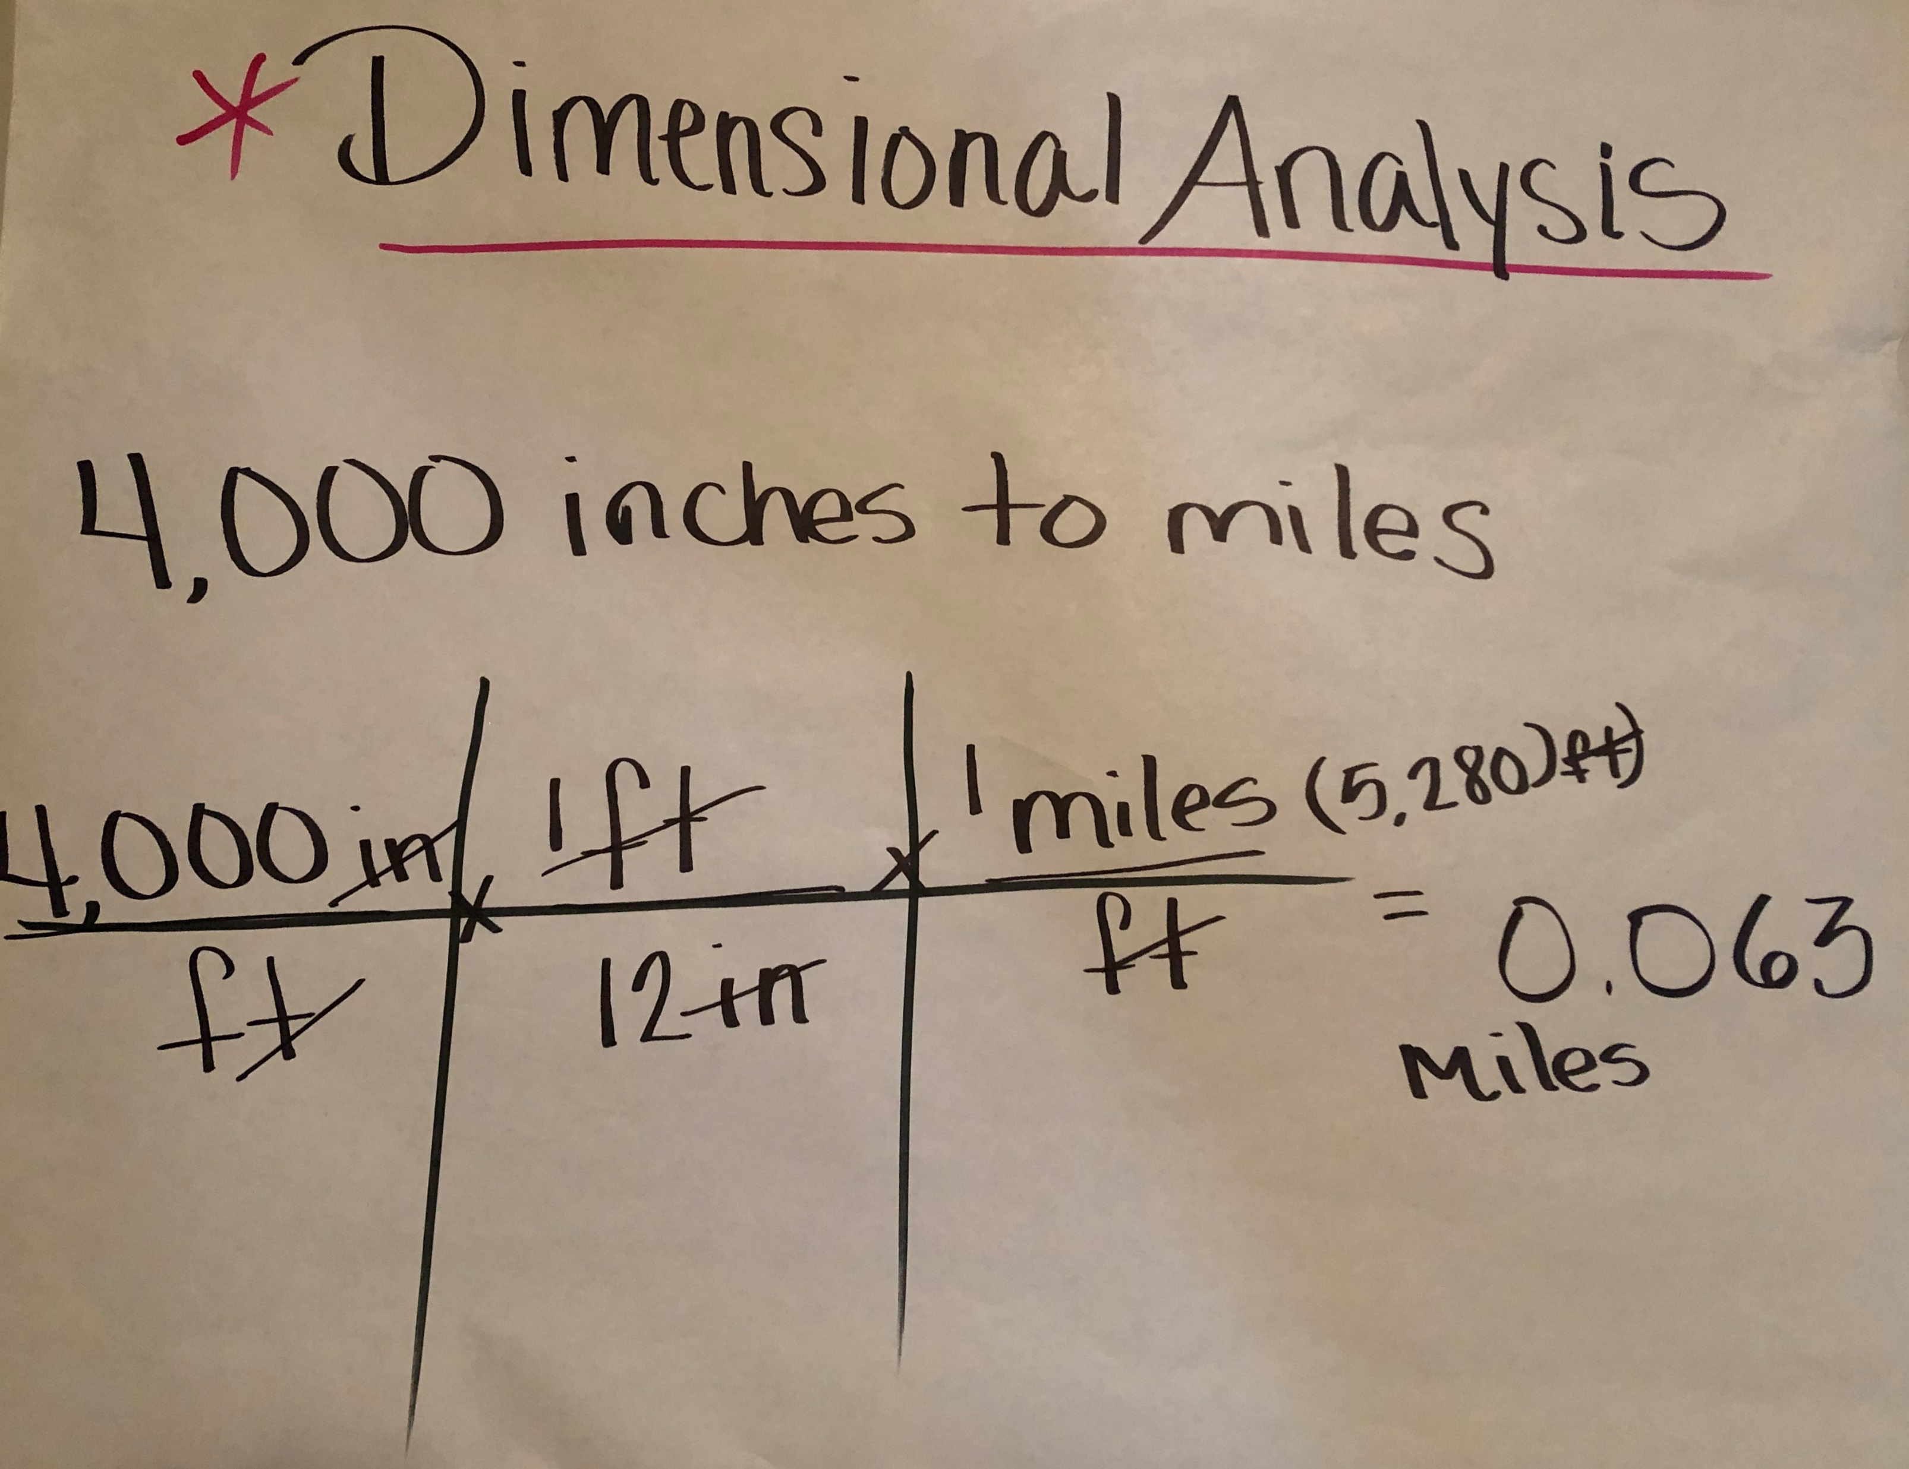
I Do Example:
Convert the speed of a glacier: 2.8 meters per year into inches per hour.
1 year = 365 days
1 day = 24 hours
1 hour = 60 minutes
1 minute = 60 seconds
1 meter = 3.3 feet
1 foot = 12 inches
1 yard = 3 feet
1 miles = 5280 feet

Slide 8
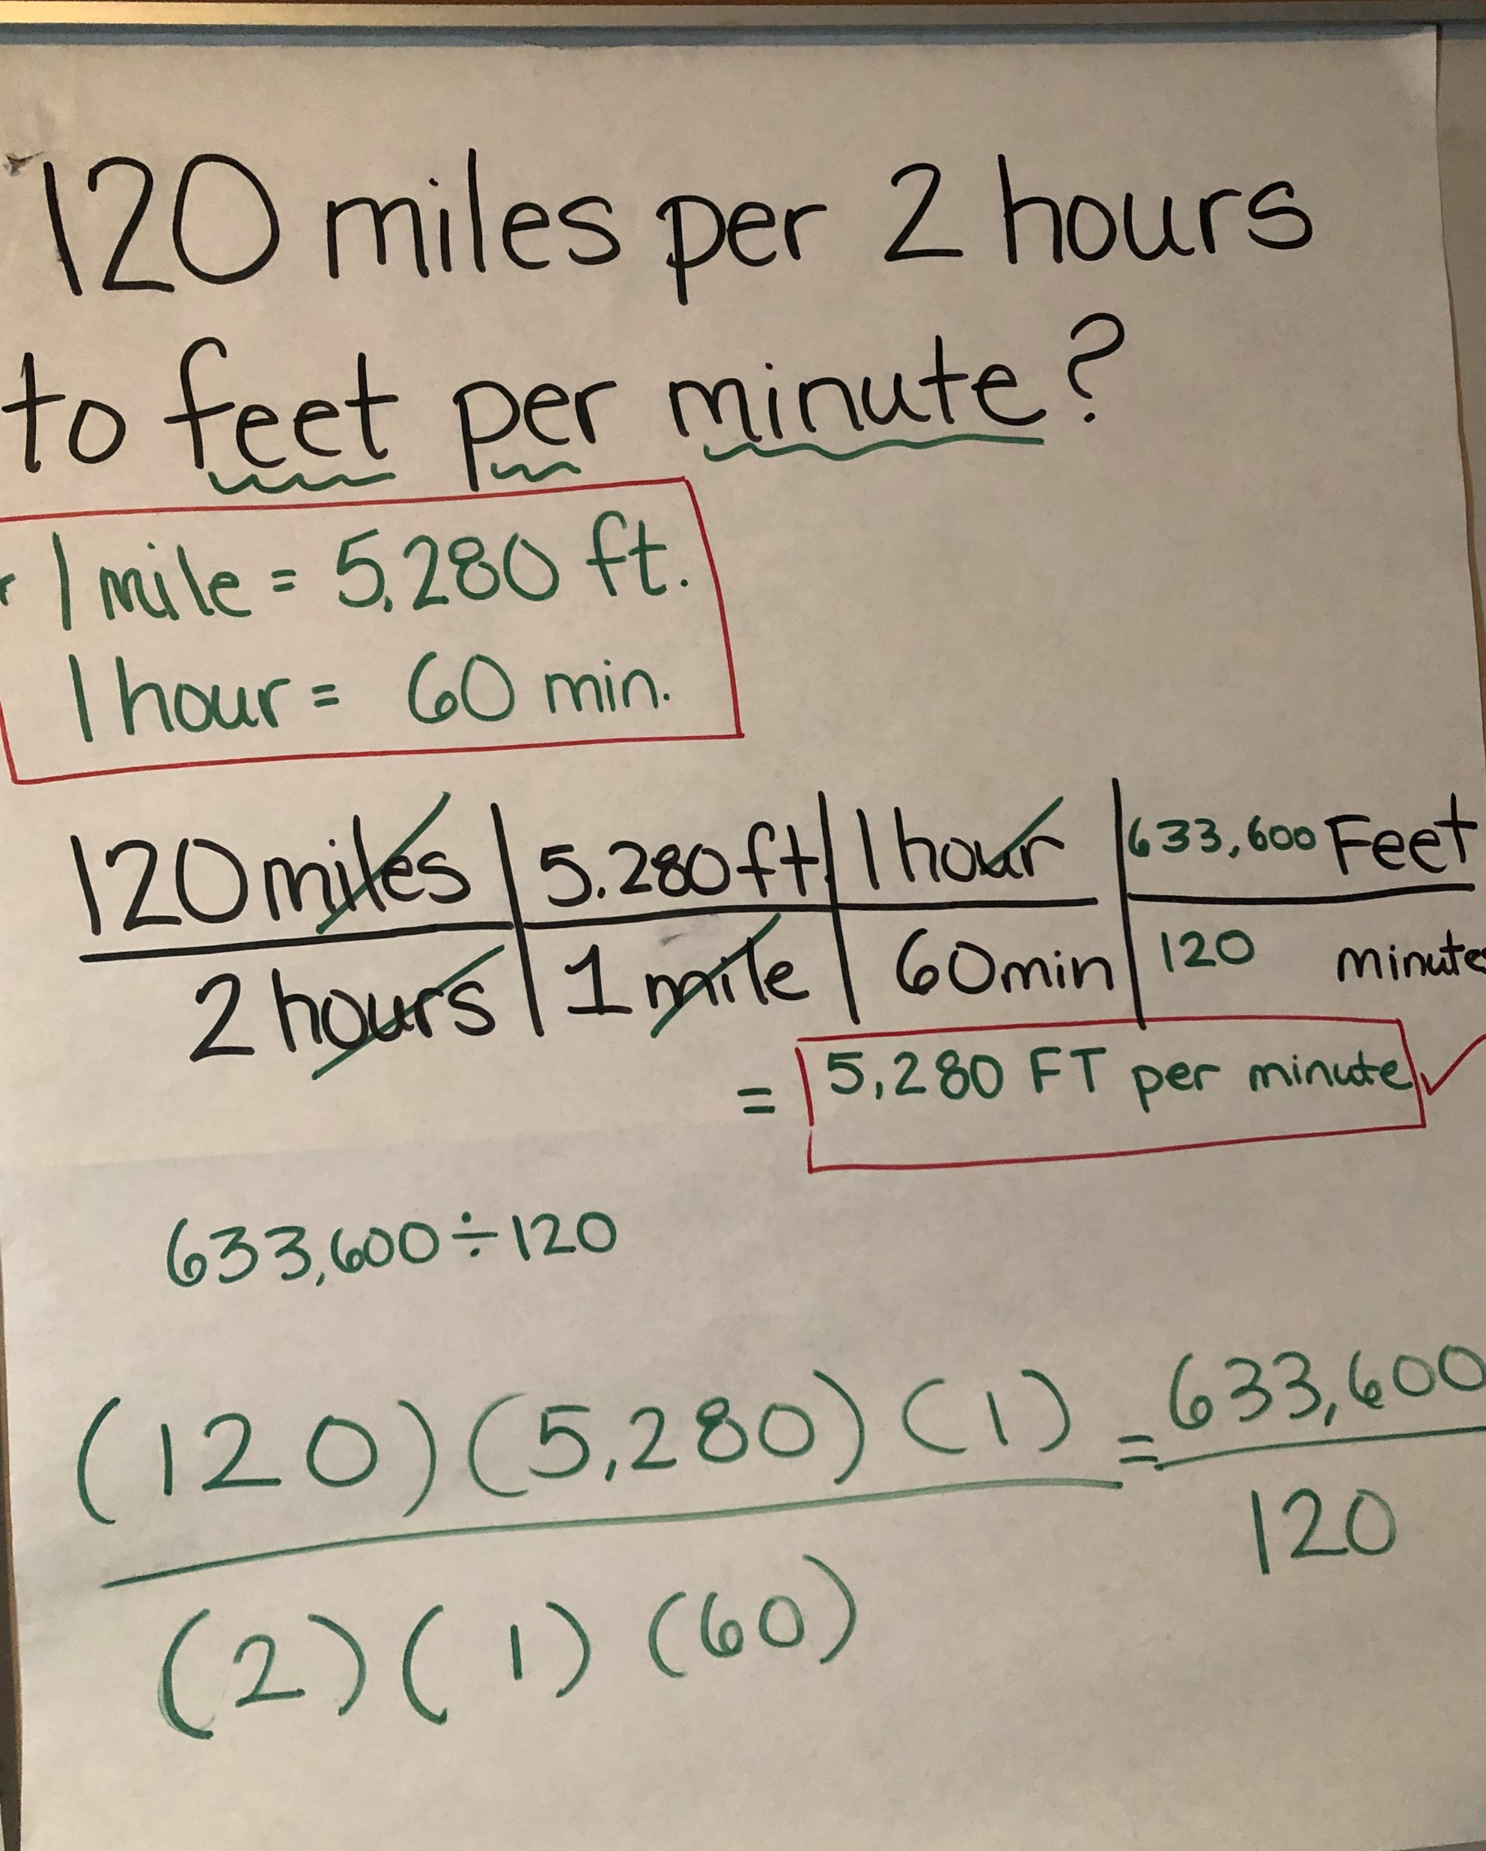
We Do Example:
Running 7 miles in 4 weeks to feet per second.
1 year = 365 days
1 day = 24 hours
1 hour = 60 minutes
1 minute = 60 seconds
1 meter = 3.3 feet
1 foot = 12 inches
1 yard = 3 feet
1 miles = 5280 feet

Slide 9
Calculator Reminder: www.desmos.com/scientific
Goformative Rally Coach Chat:
1st Q36TBL 2nd BZXHW6 4th TCBFHG

Slide 10
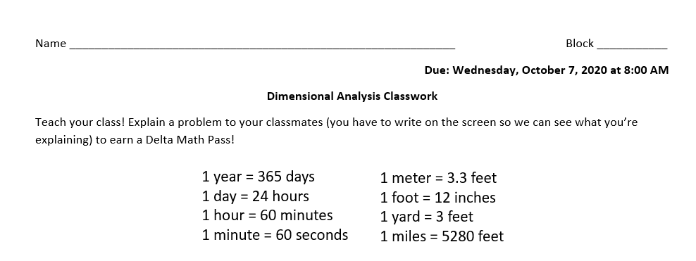
Your Chance to Teach
Working- Dimensional Analysis
Partner A: #1 and #2
Partner B: #3 and #5
http://ablythemath.weebly.com/uploads/5/9/9/1/59912995/dimensional_analysis_worksheet.pdf

Slide 11
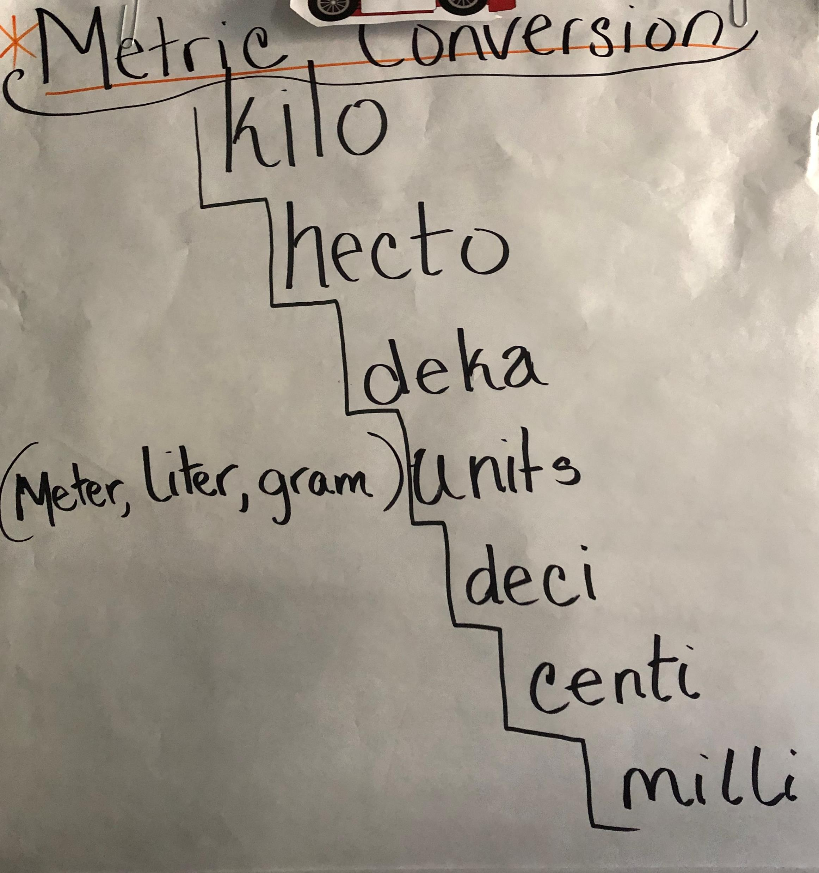
Video
Strategy Sheet

Slide 12
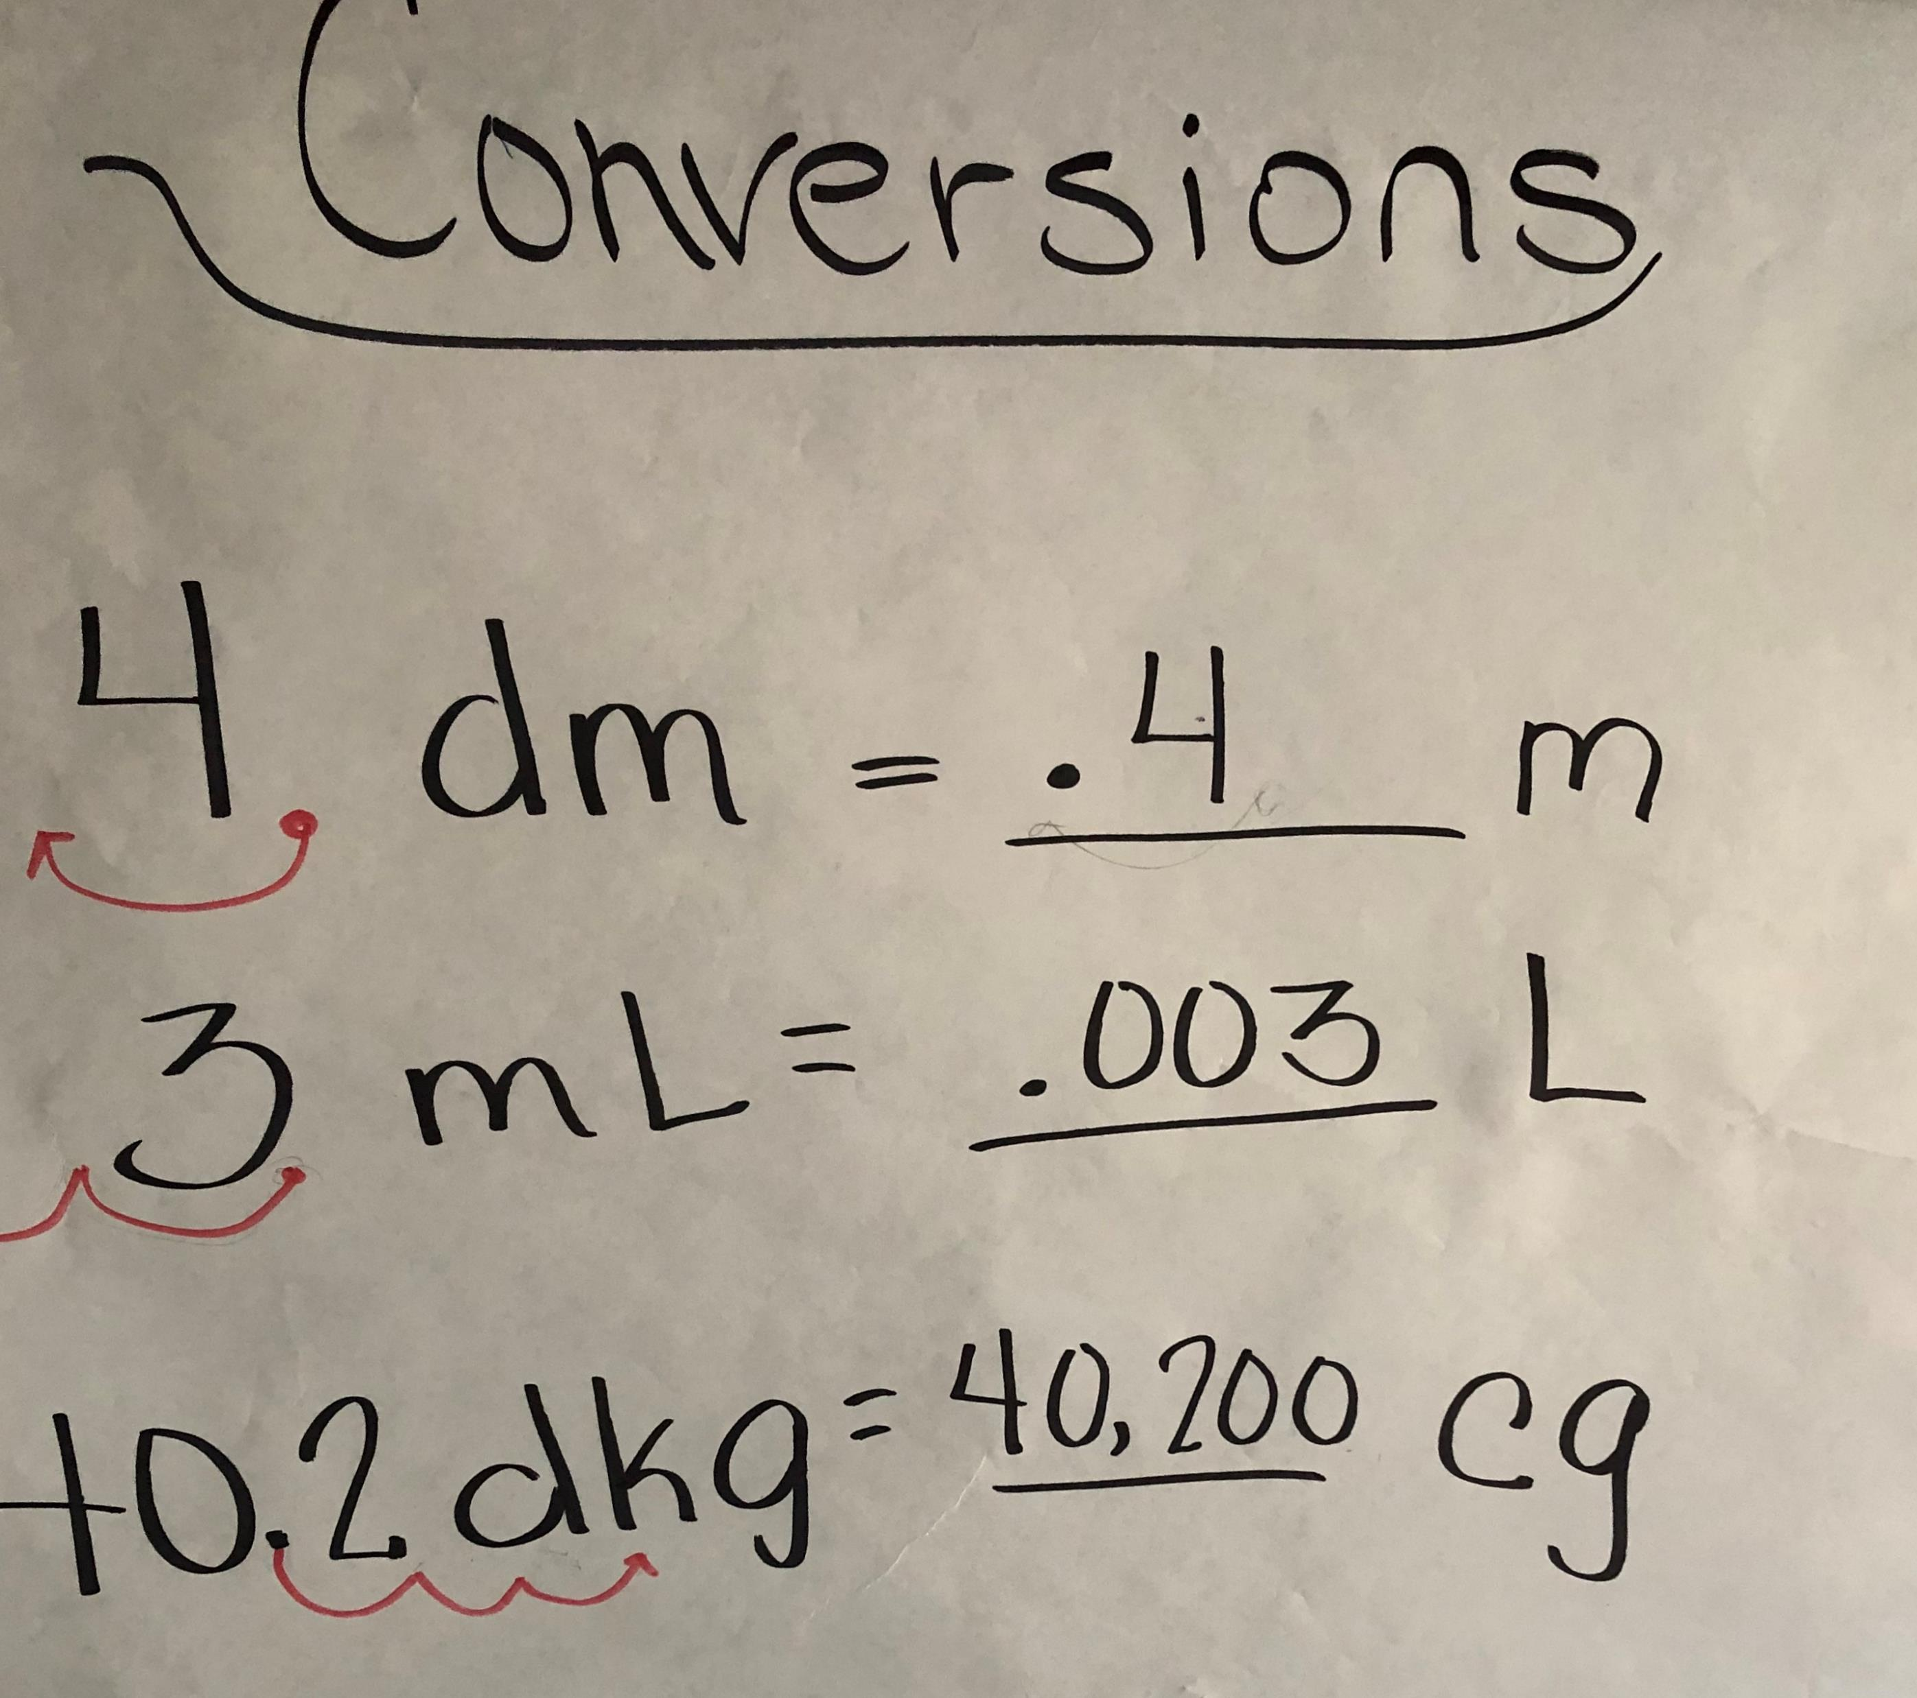
Practice Time
I Do
We Do
You Do

Slide 13
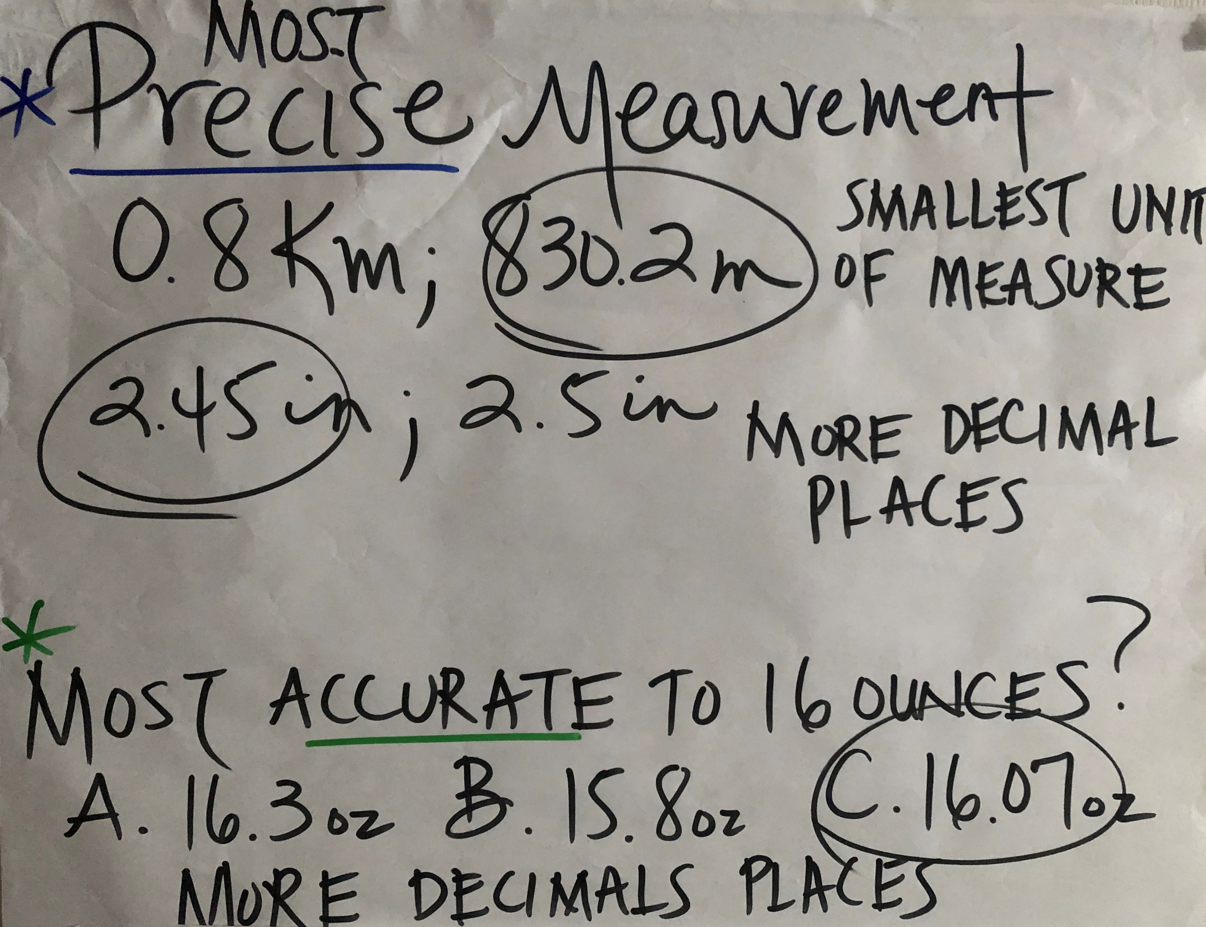
Smallest Unit
More Decimal Places

Slide 14
Closing: Gradebook updates
1. Delta Math #1-5 (Mon Night)
2. Delta Math #6-10 (Tues Night)
3. Go Formative #1 and 2 (Mon Night)
4. Go Formative #3 and #5 (Tues Night)
Upload Go Formatives to CTLS during Closing
Wednesday’s Plan
5. Delta Math Thursday on Word Problems
6. Delta Math Friday on Properties
Total Grades for Week 7 10/5 – 10/9 = 6

